Slide 1
5F
'
s

Slide 2
FUN
FRIENDSHIP
FIT
FREEDOM
FUTURE

Slide 3
FUN
THE PLACE WHERE THE FUN NEVER STOPS!

Slide 4
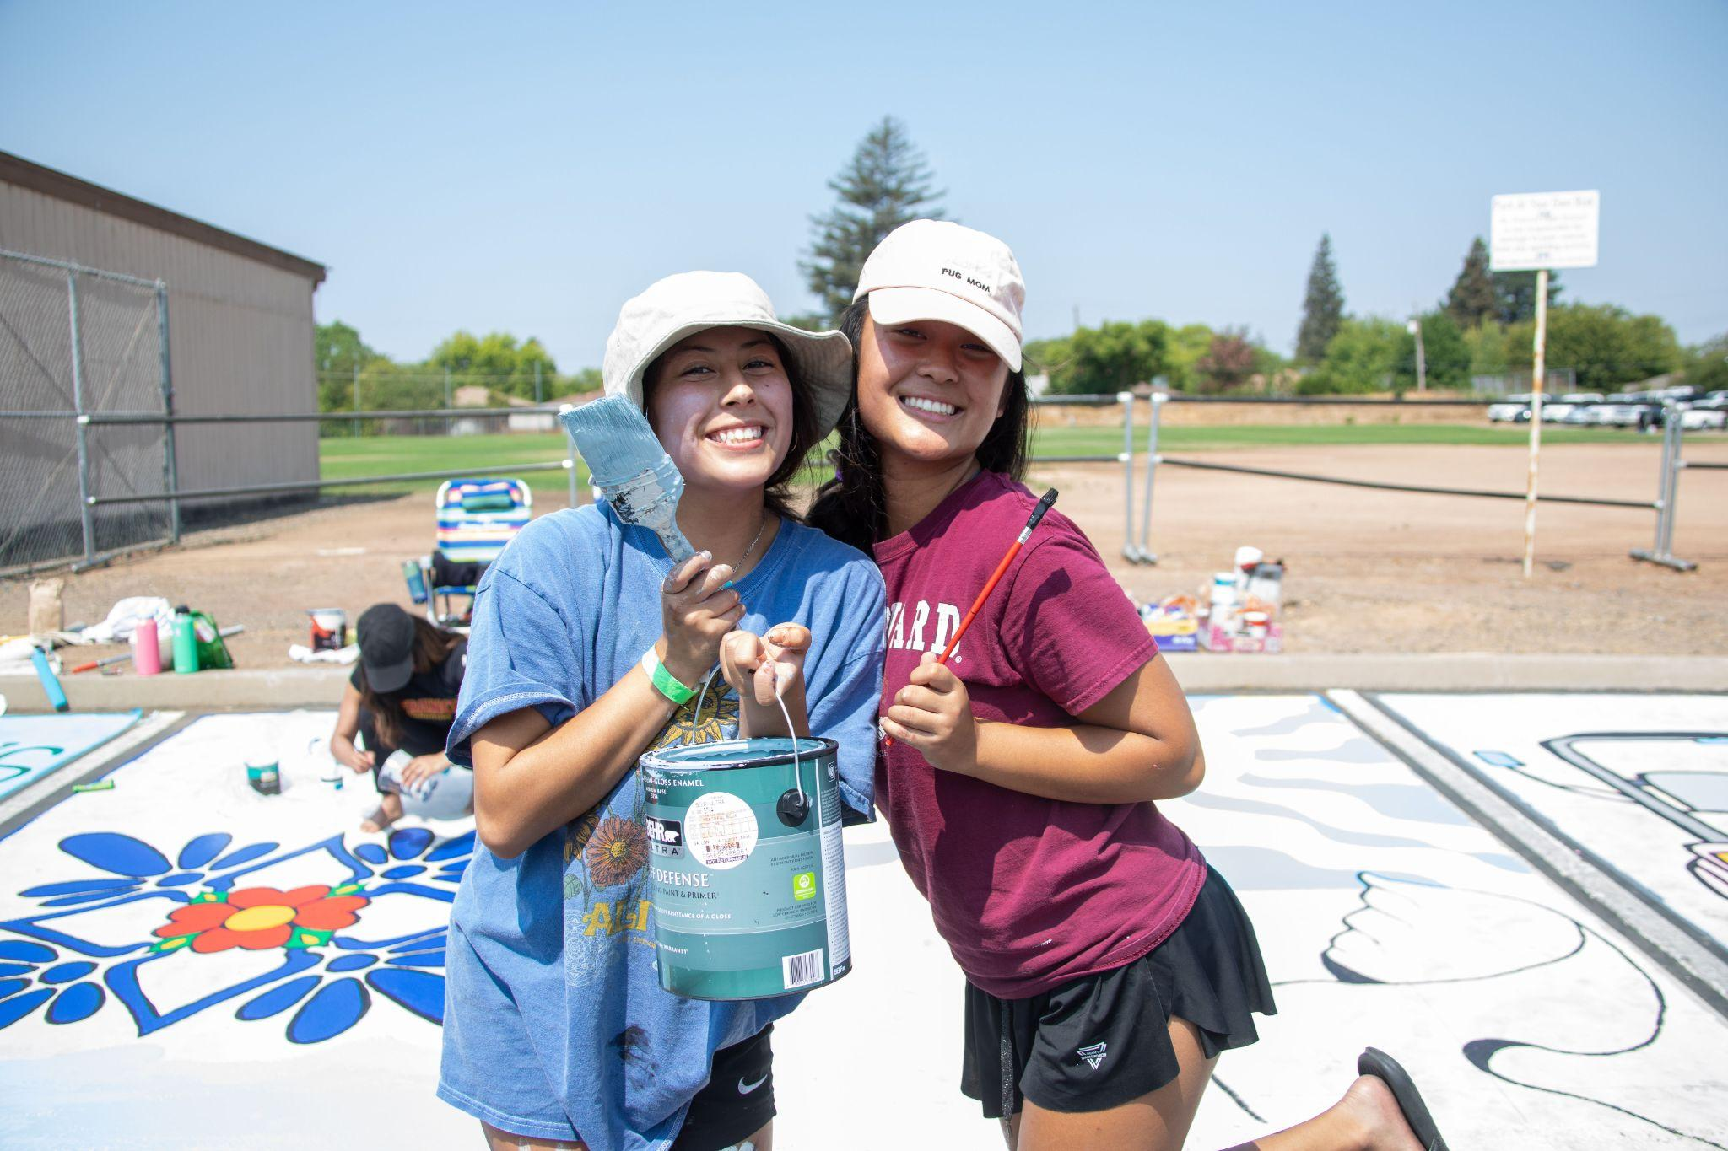
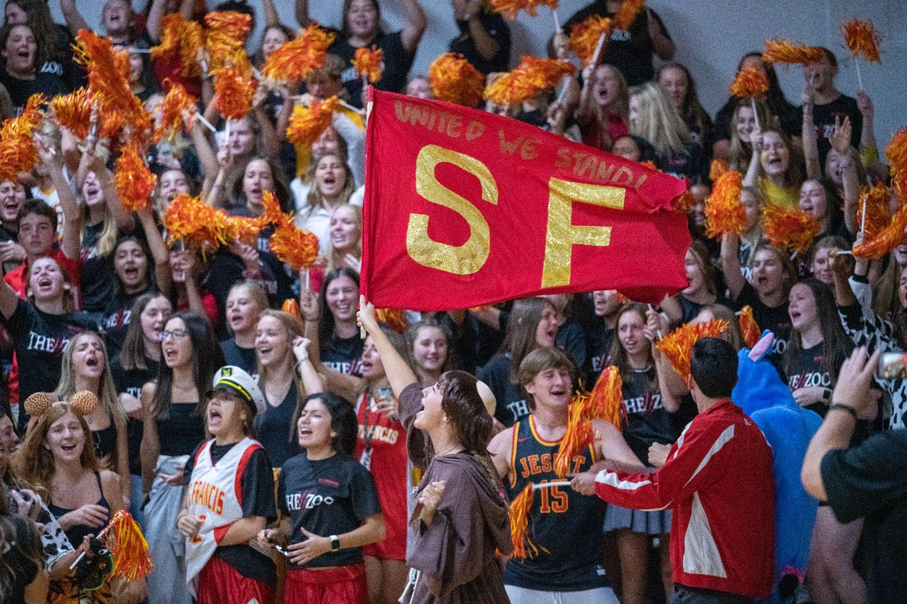
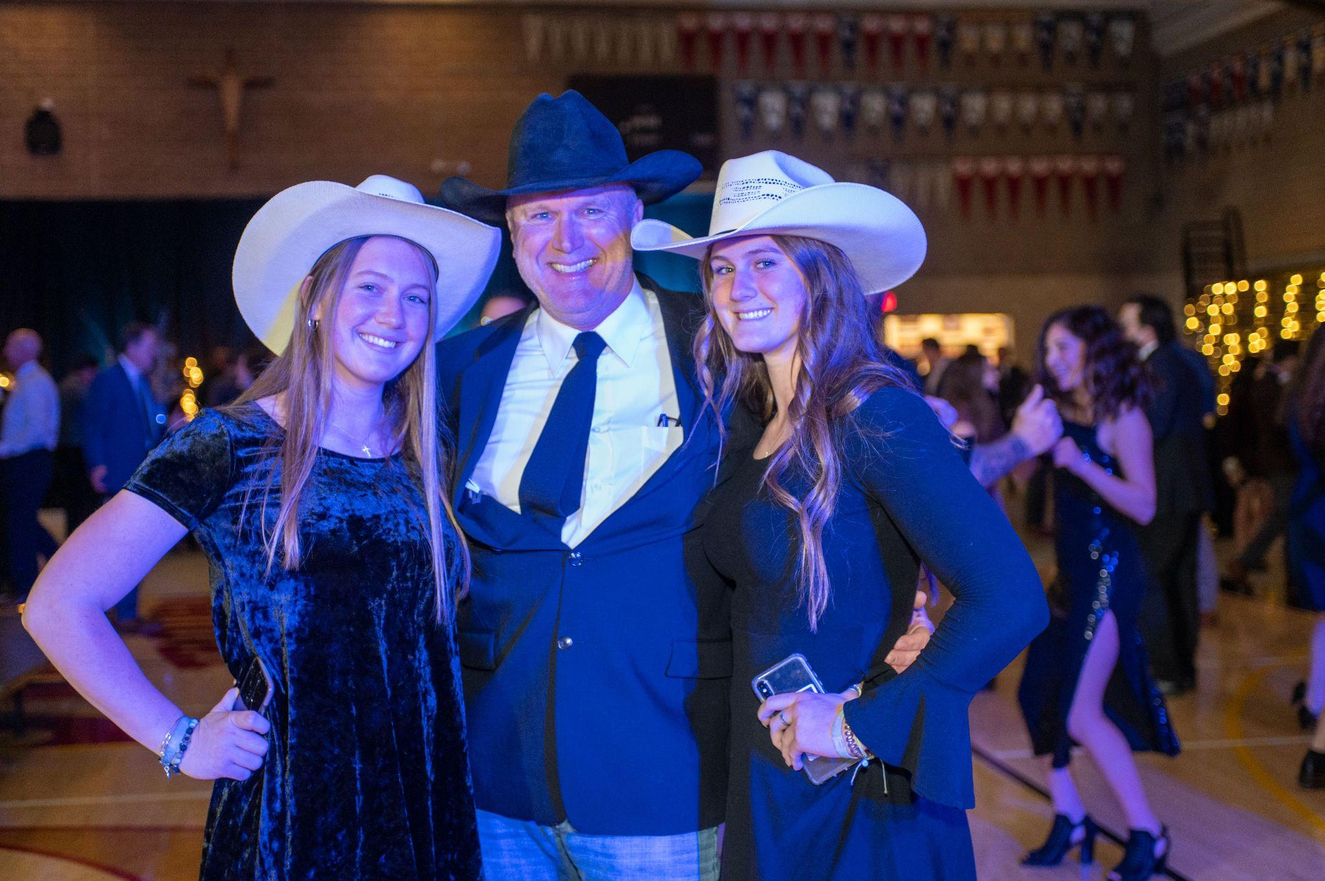
TRADITIONS
Class Mascots
Meet a Parent/ Grandparent for lunch
Painted Parking Spots
SWAP Day
St. Francis Day
Father Daughter Dance
Mom Prom
And … Homecoming

Slide 5
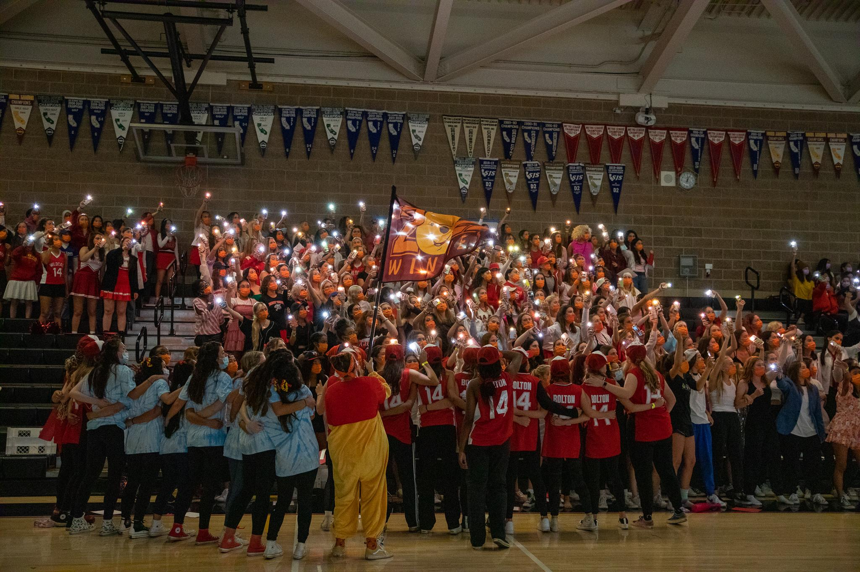
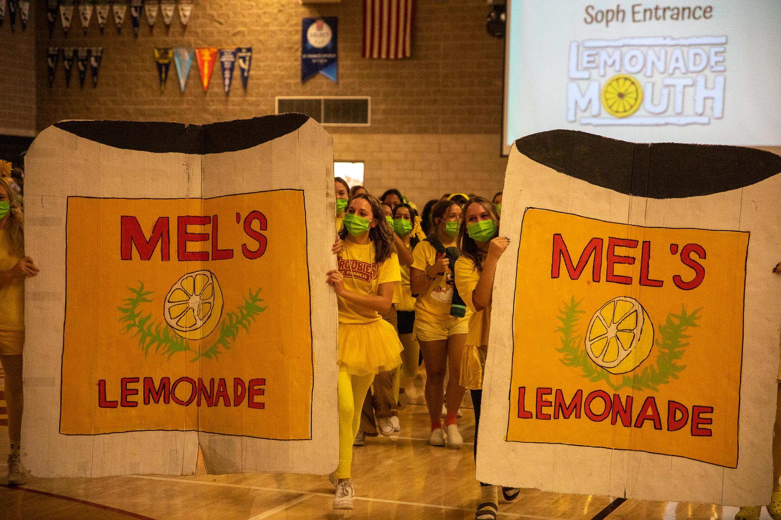
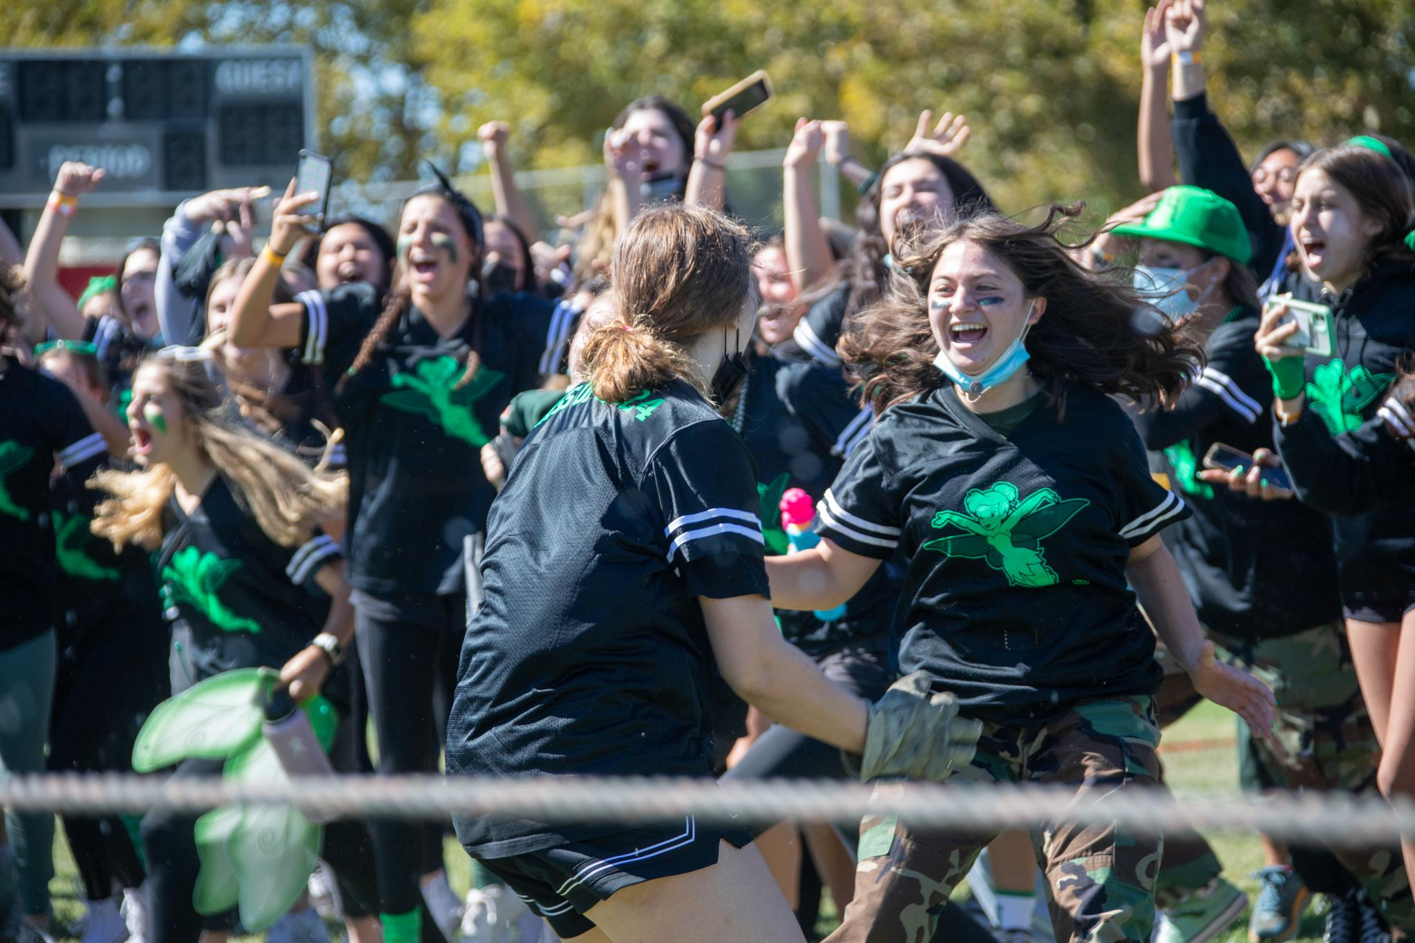
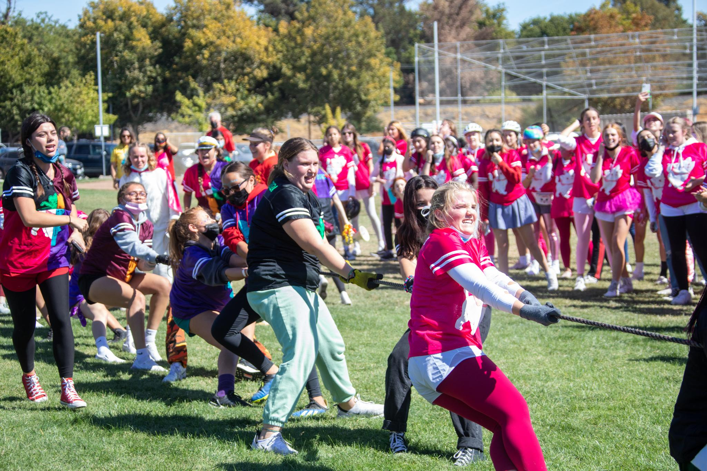
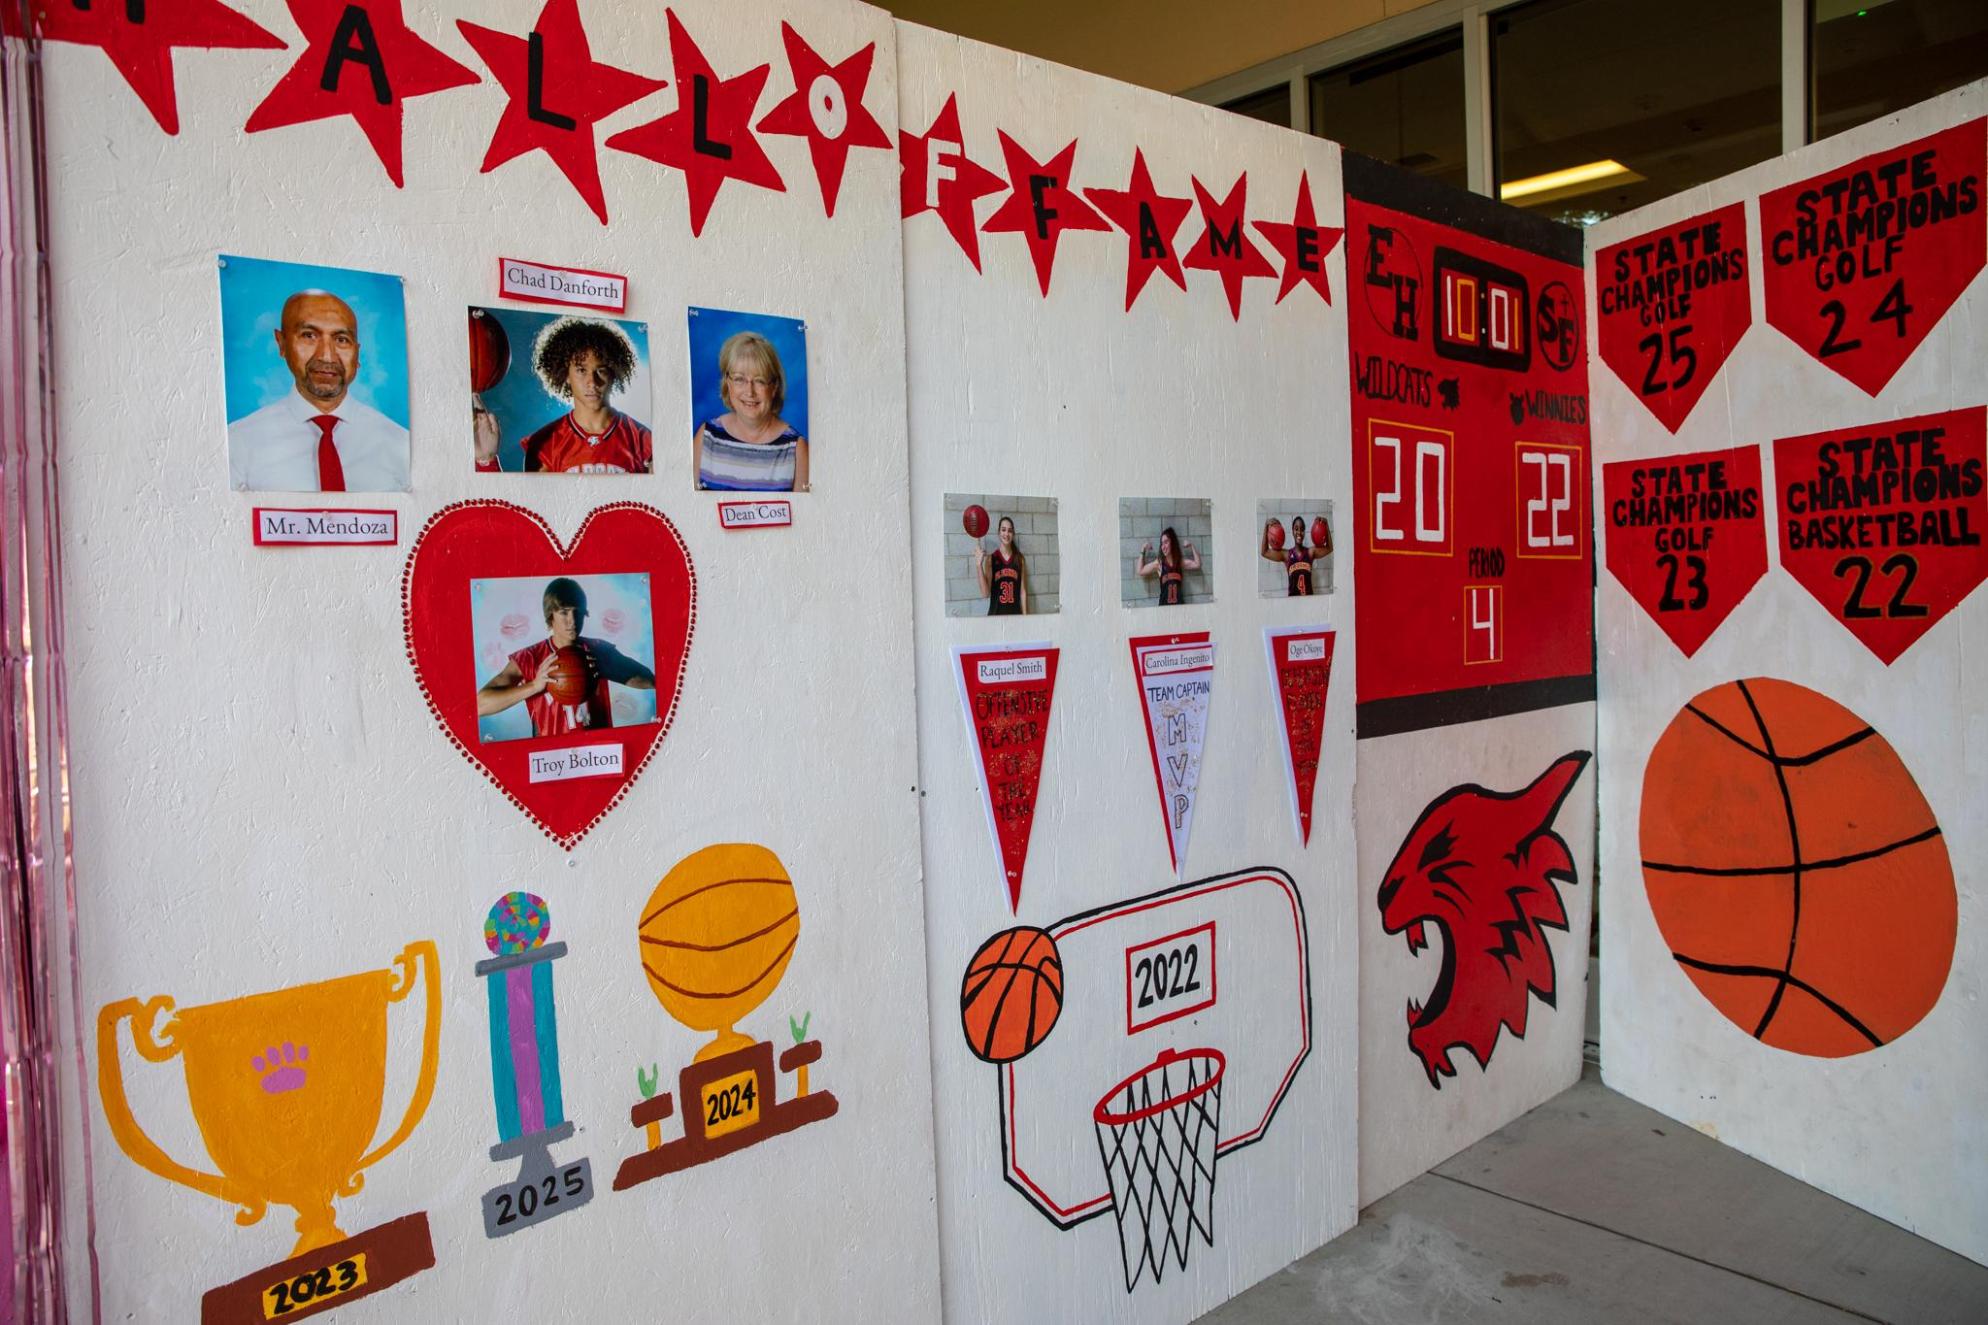
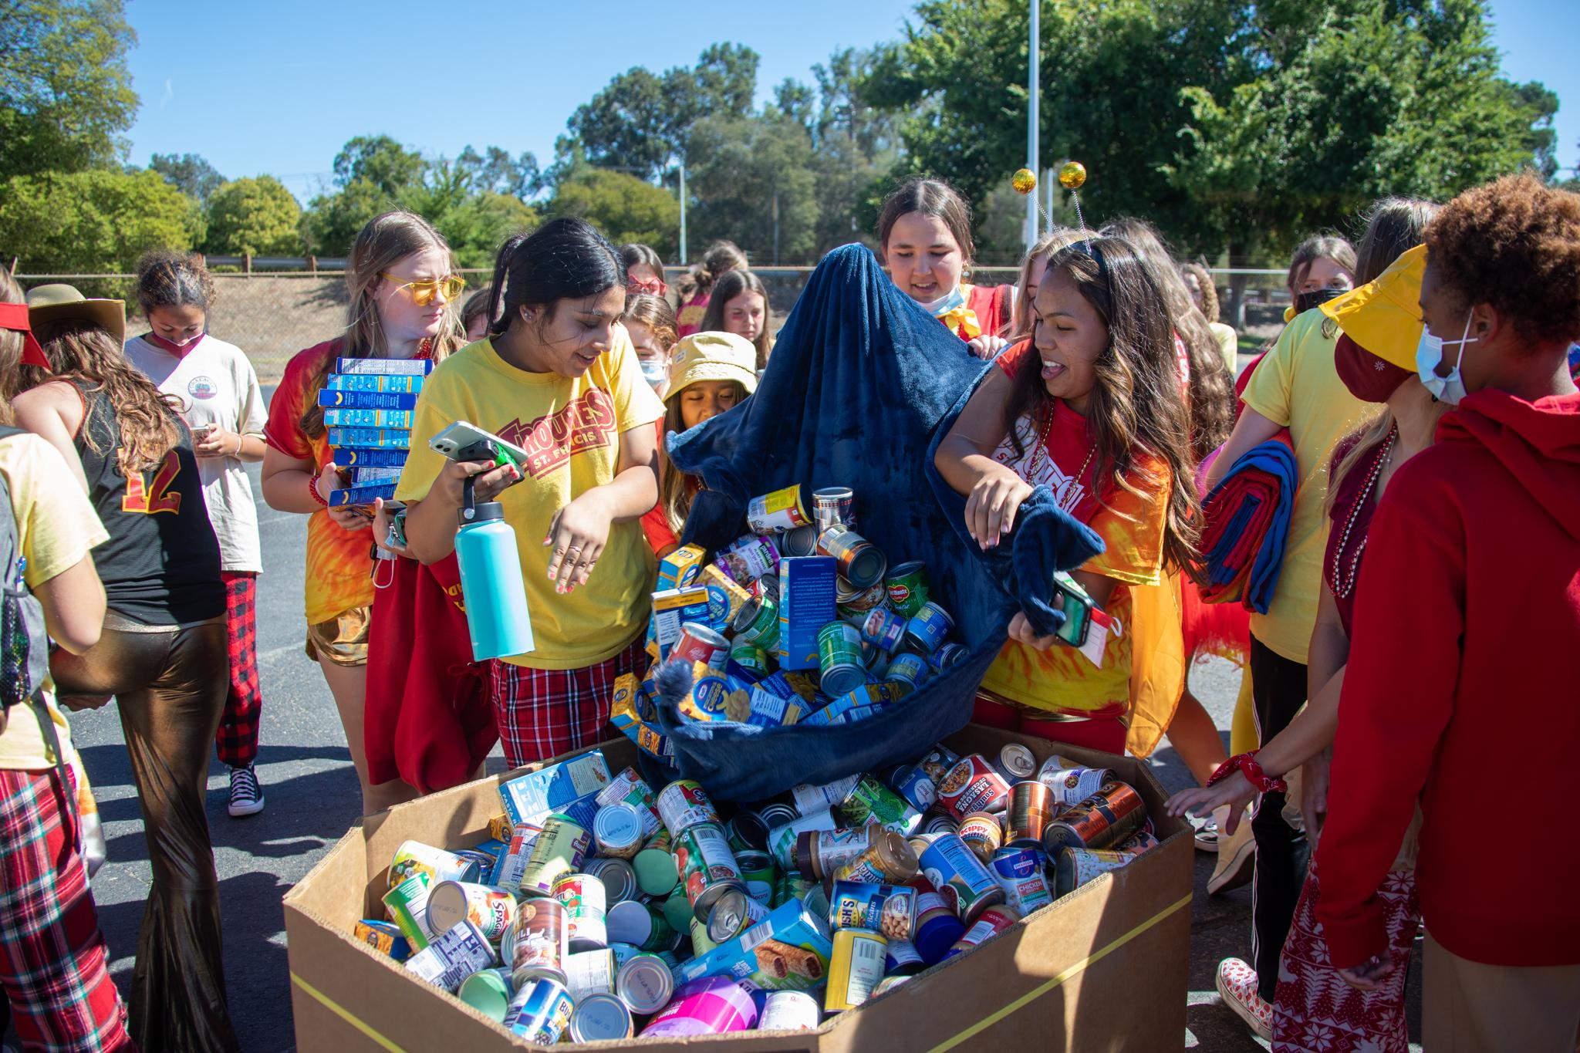
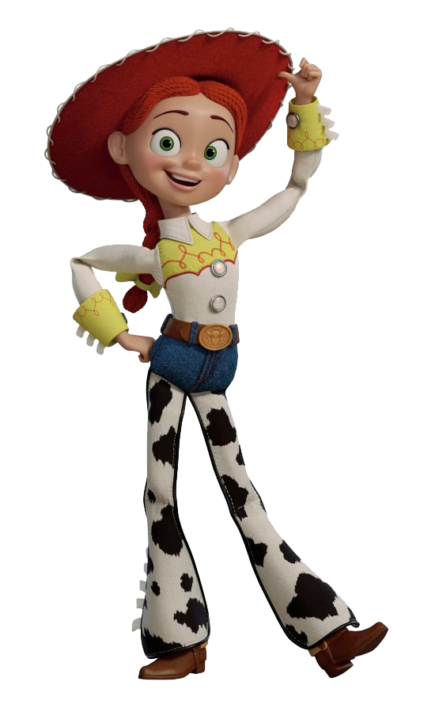
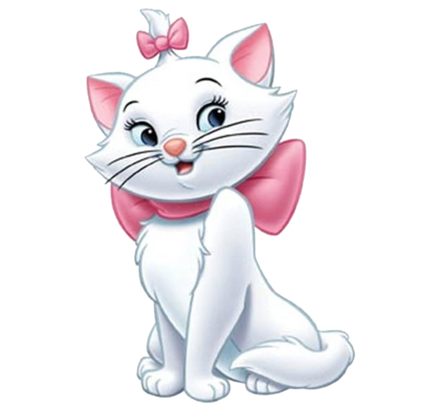
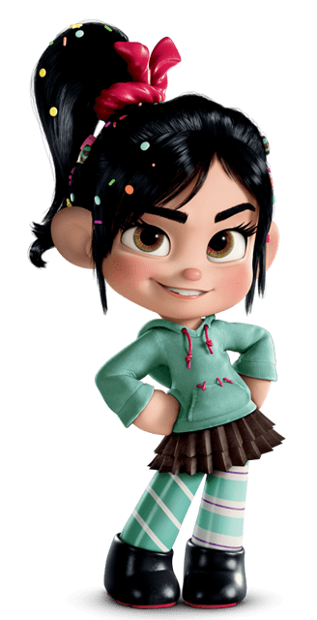
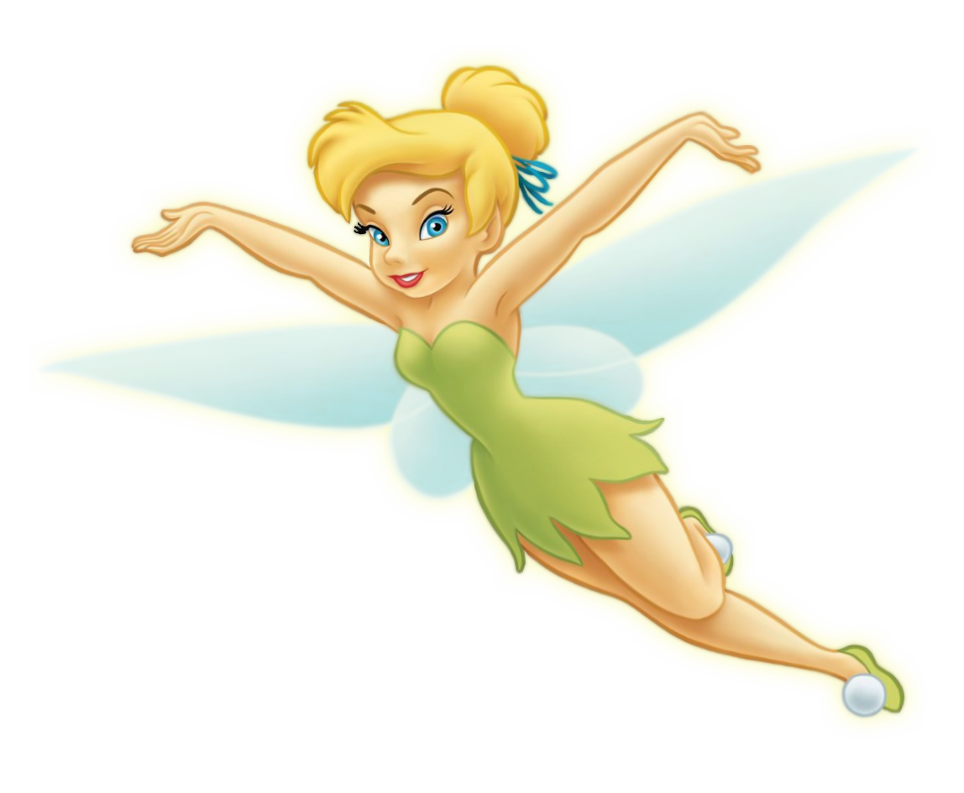
HOMECOMING

Slide 6
HOMEROOM
HITS

Slide 7
FRIENDSHIP
YOU JUST GAINED 880 NEW SISTERS!

Slide 8
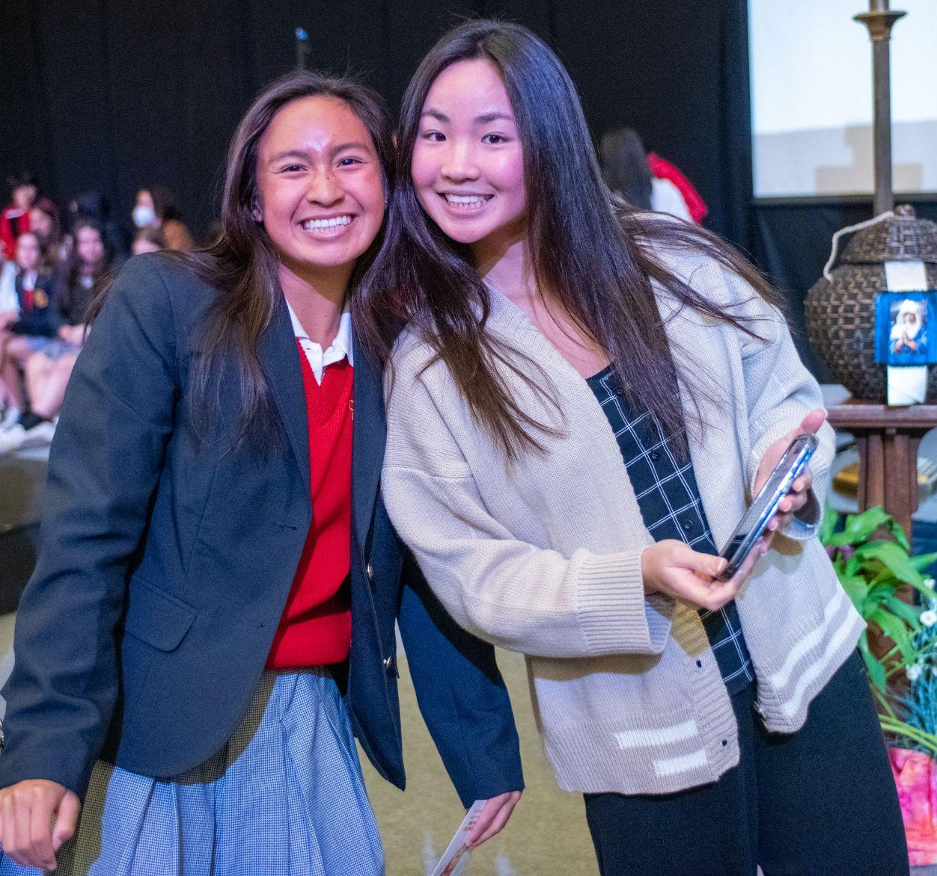
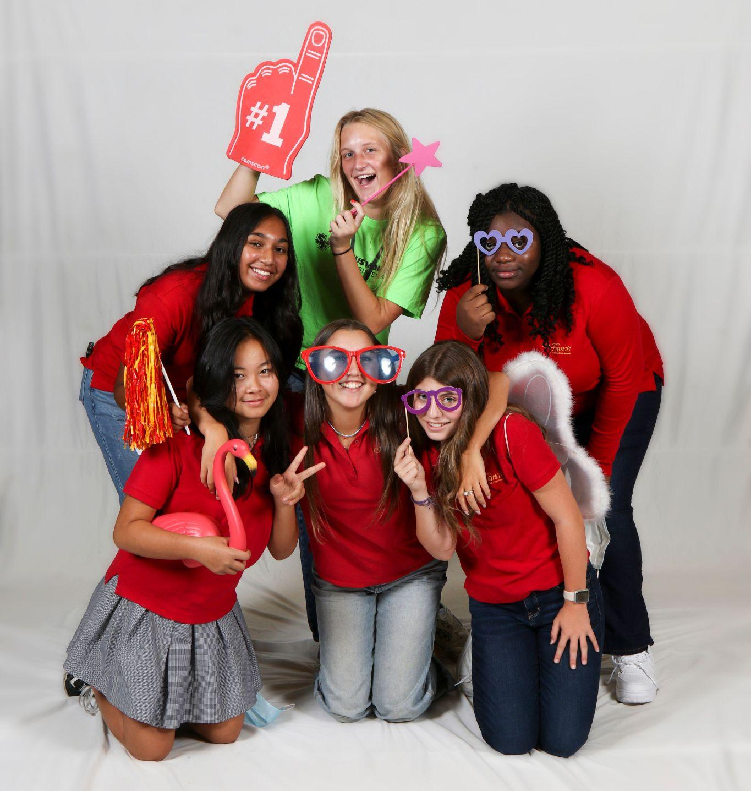
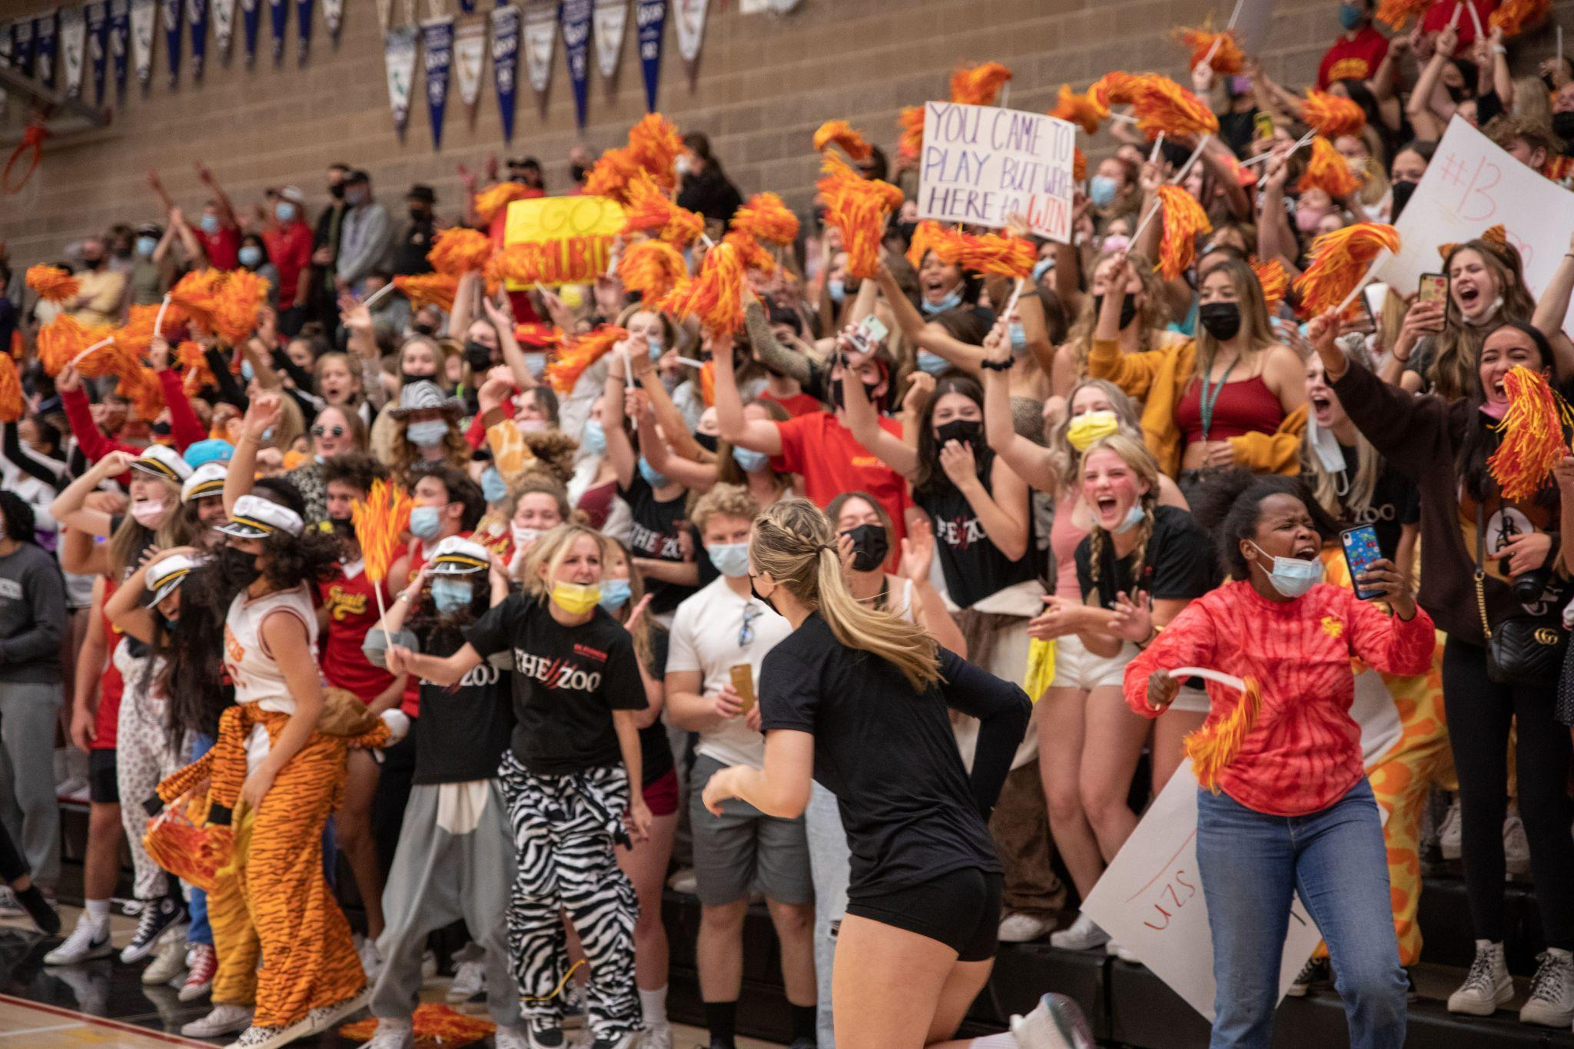
SISTERHOOD
Big Sister/ Little Sister
Freshman Orientation
Freshman Overnight
The Zoo
Honor Guards

Slide 9
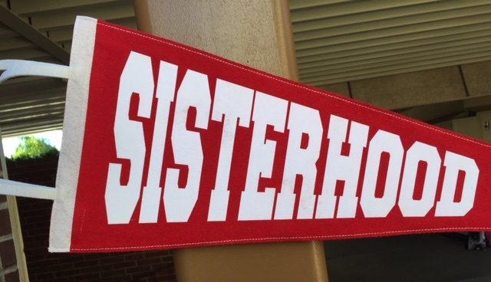
everlasting
CONNECTION
FAMILY
LOYALTY
Trust
SUPPORT
sharing
Feeling at home
Community
Unity
understanding
Belonging
always there for you
Not feeling judged
NO MATTER WHAT
loving
Friendship
BONDS THAT LAST A LIFETIME
Inclusion
Making memories
HAVING EACH OTHER’S BACKS
ACCEPTANCE
Lifting Each Other Up

Slide 10
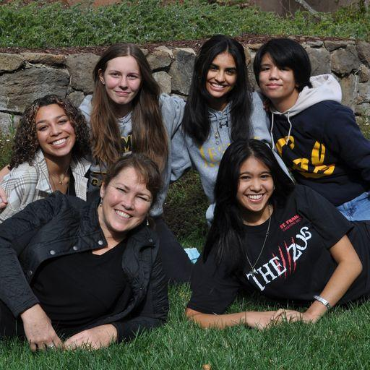
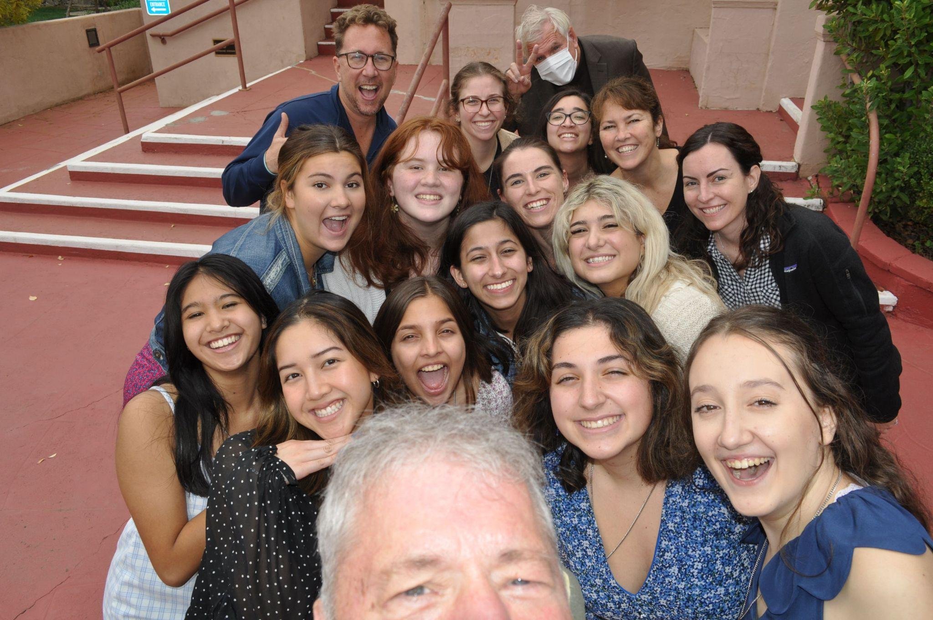
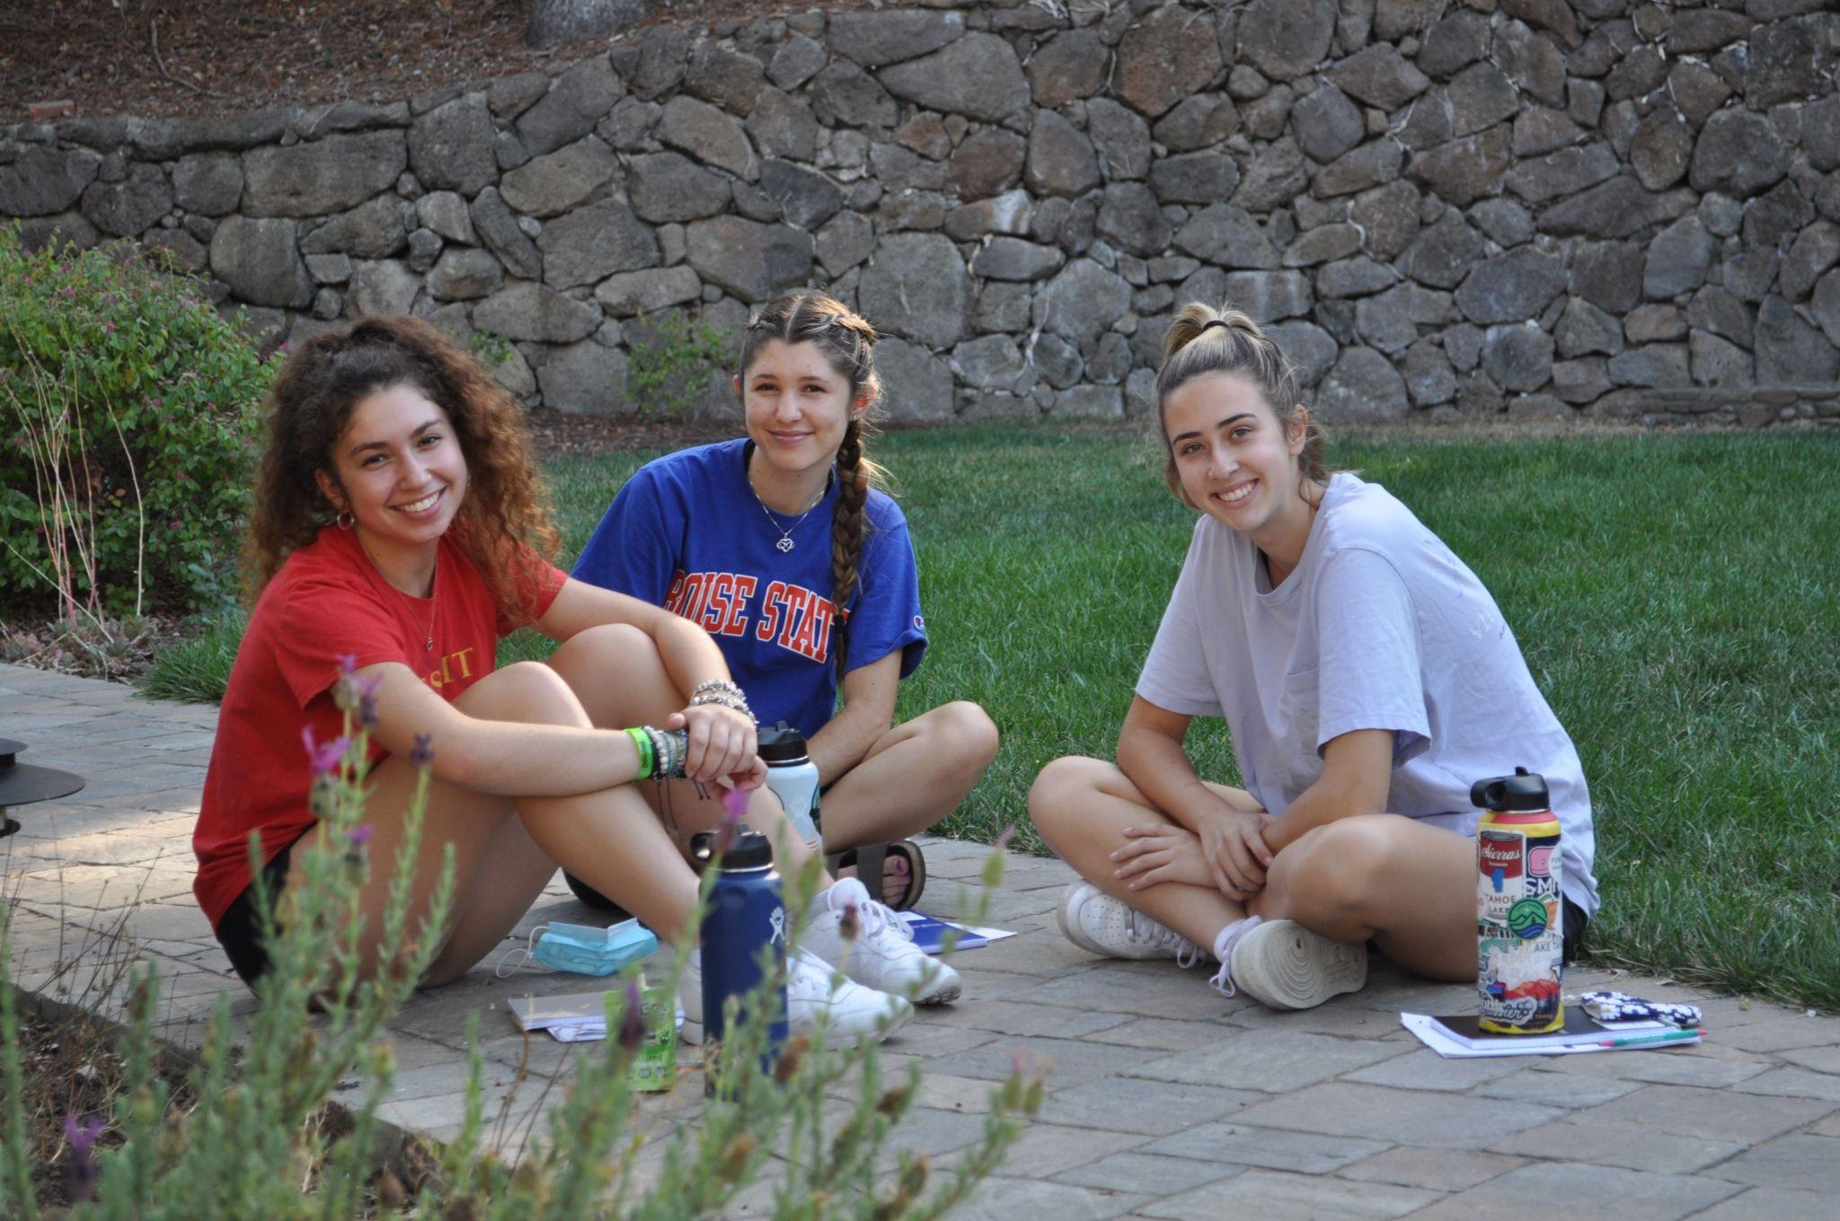
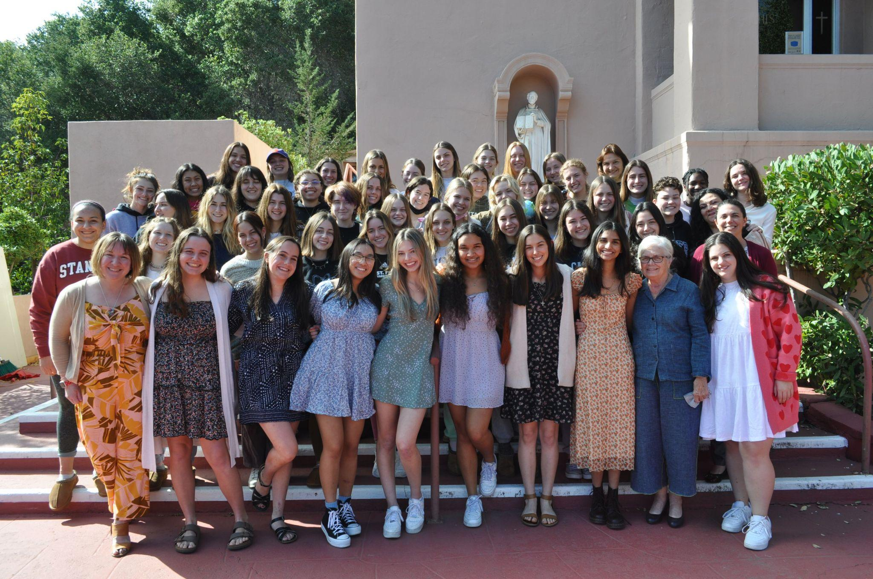
RETREATS
Meeting new sisters
Time to reflect
Growing with your faith tradition

Slide 11
FIT
IF THE SCHOOL FITS . . . CHOOSE IT!

Slide 12
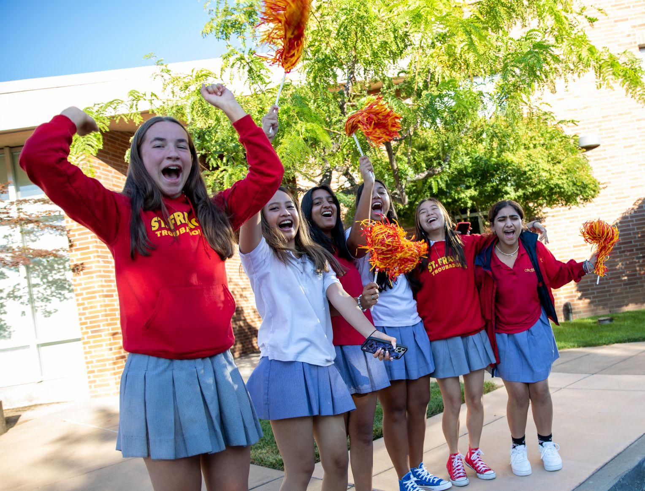
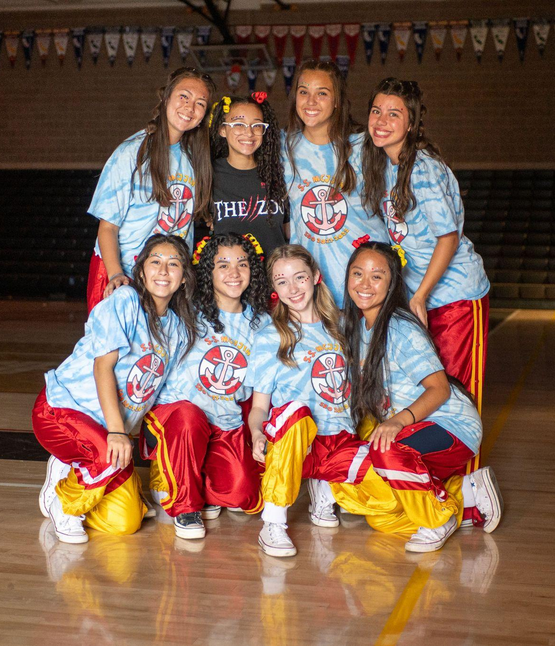
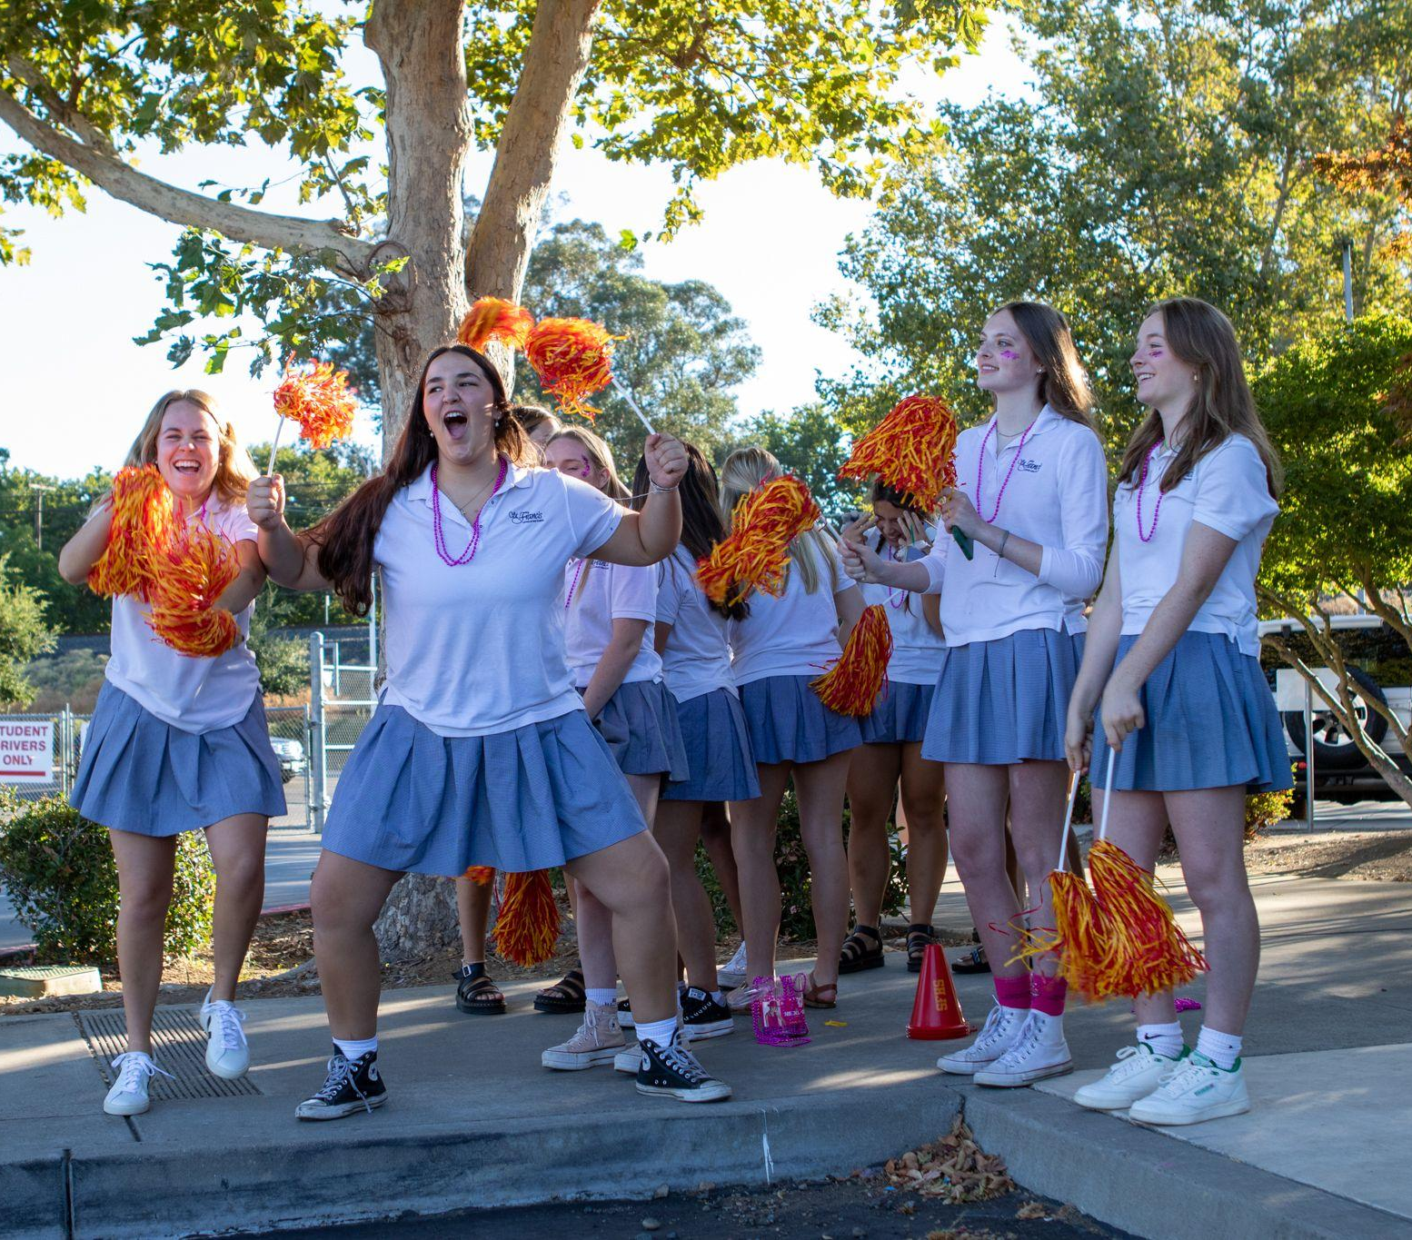
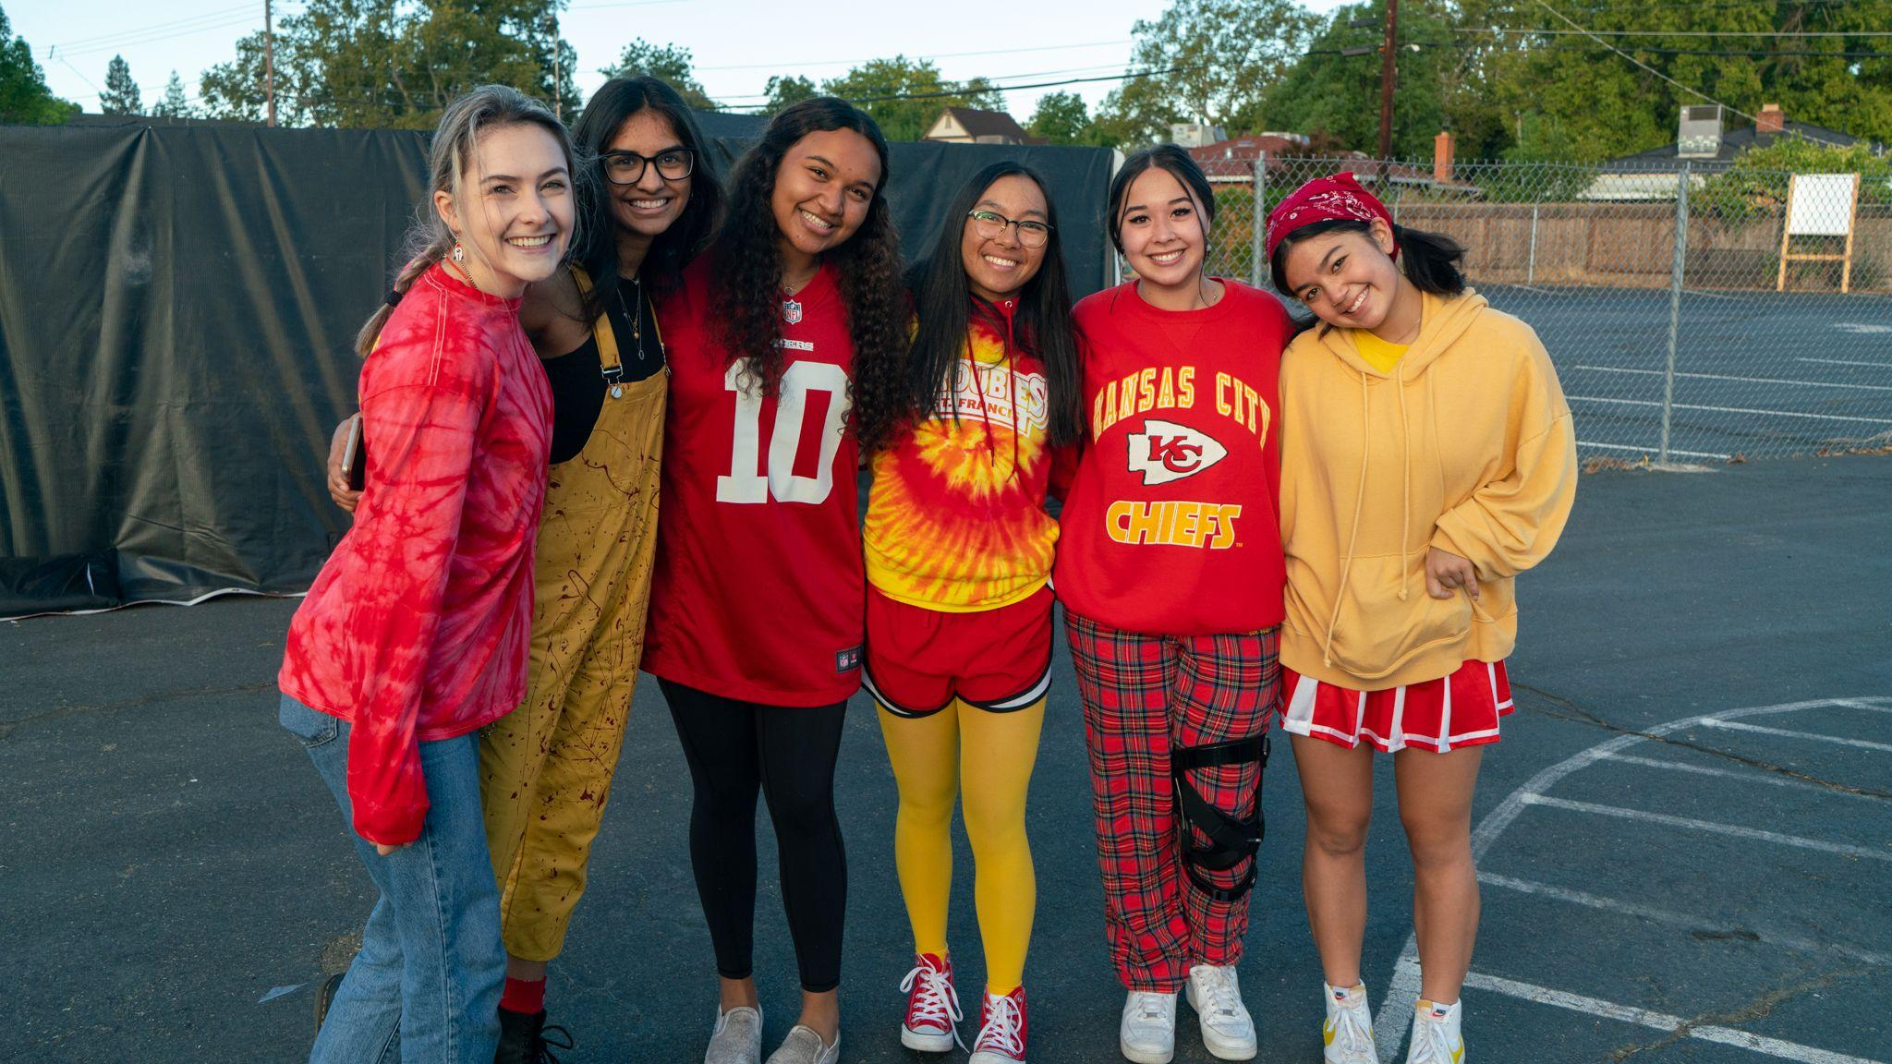
SHADOW DAY
8th grade girls
Experience what it is like to be an SF Troubadour!
Not just high school, her school………

Slide 13
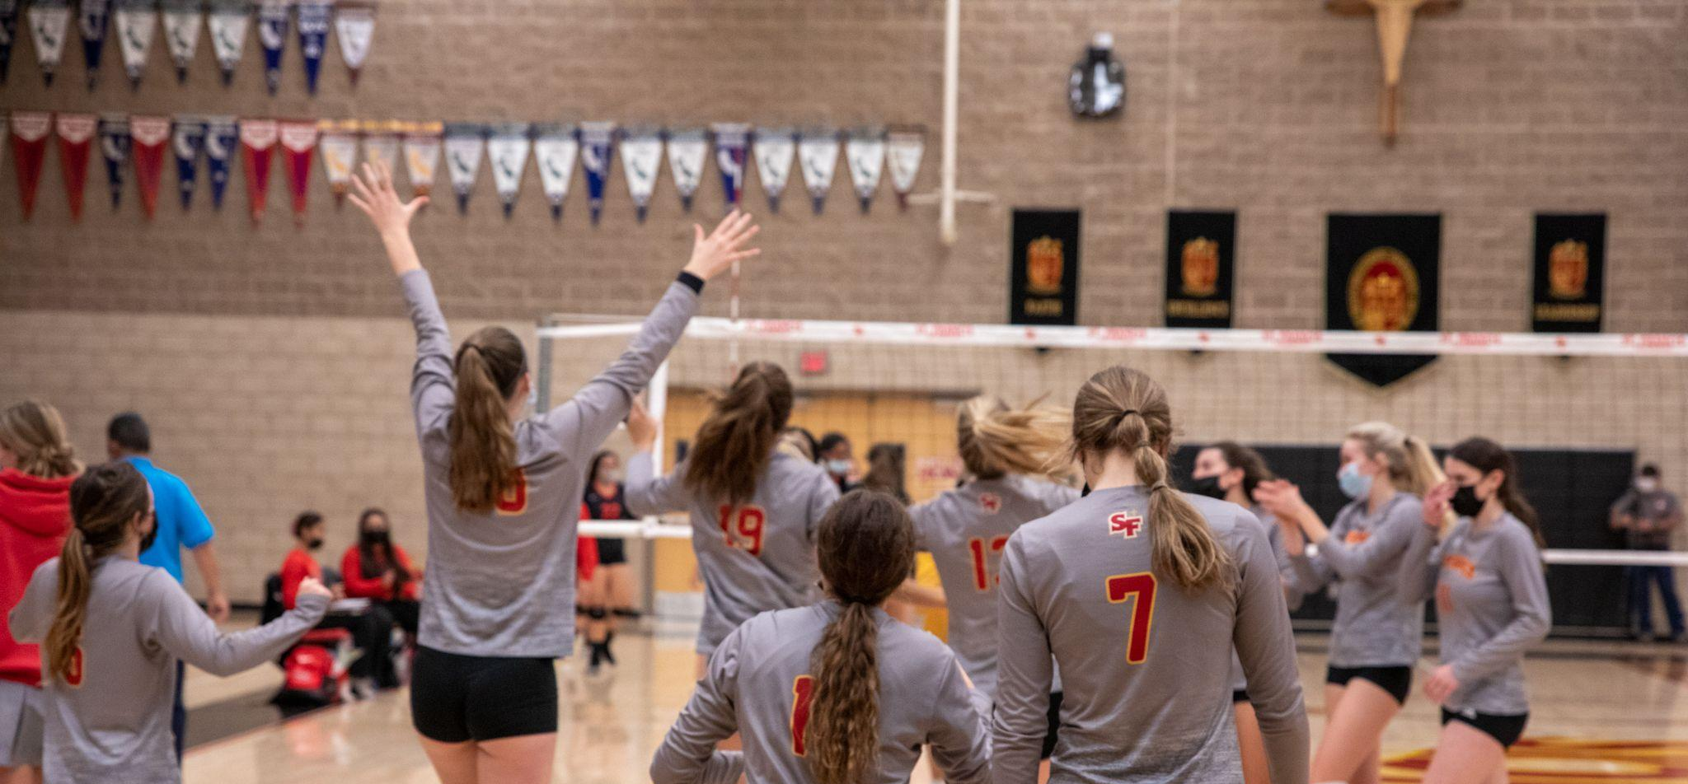
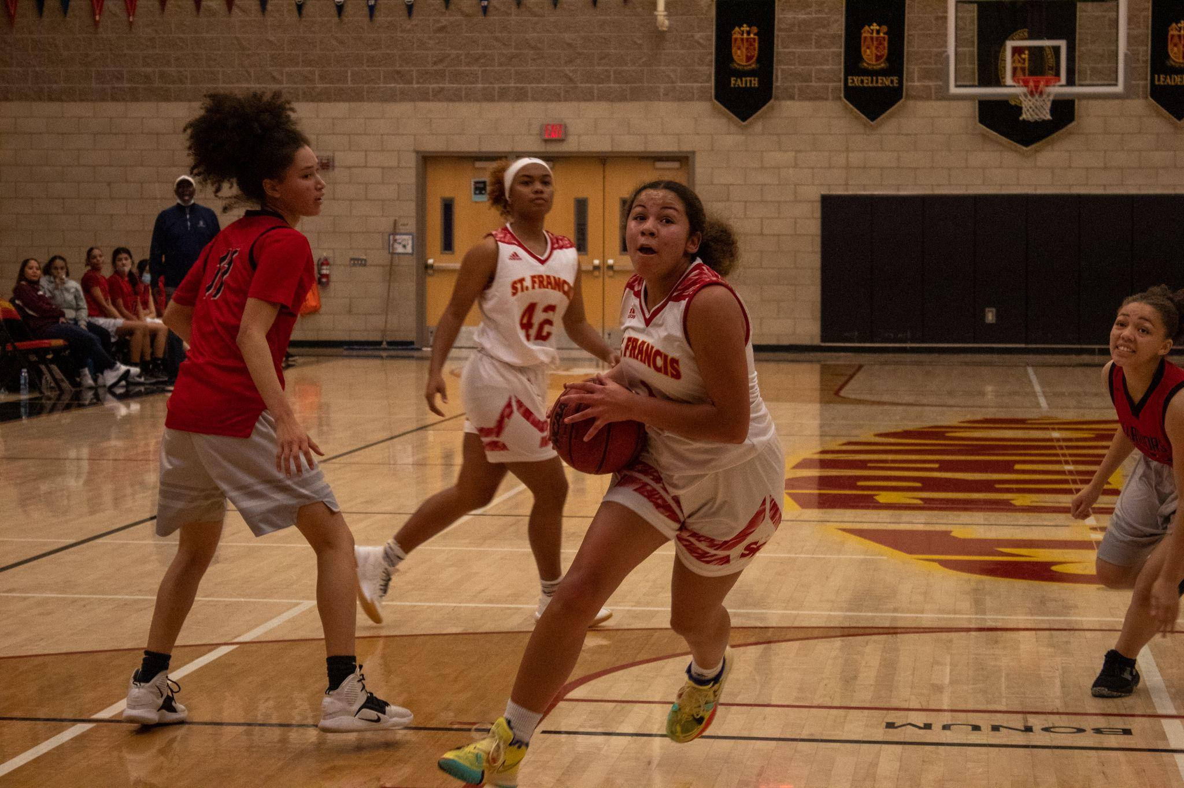
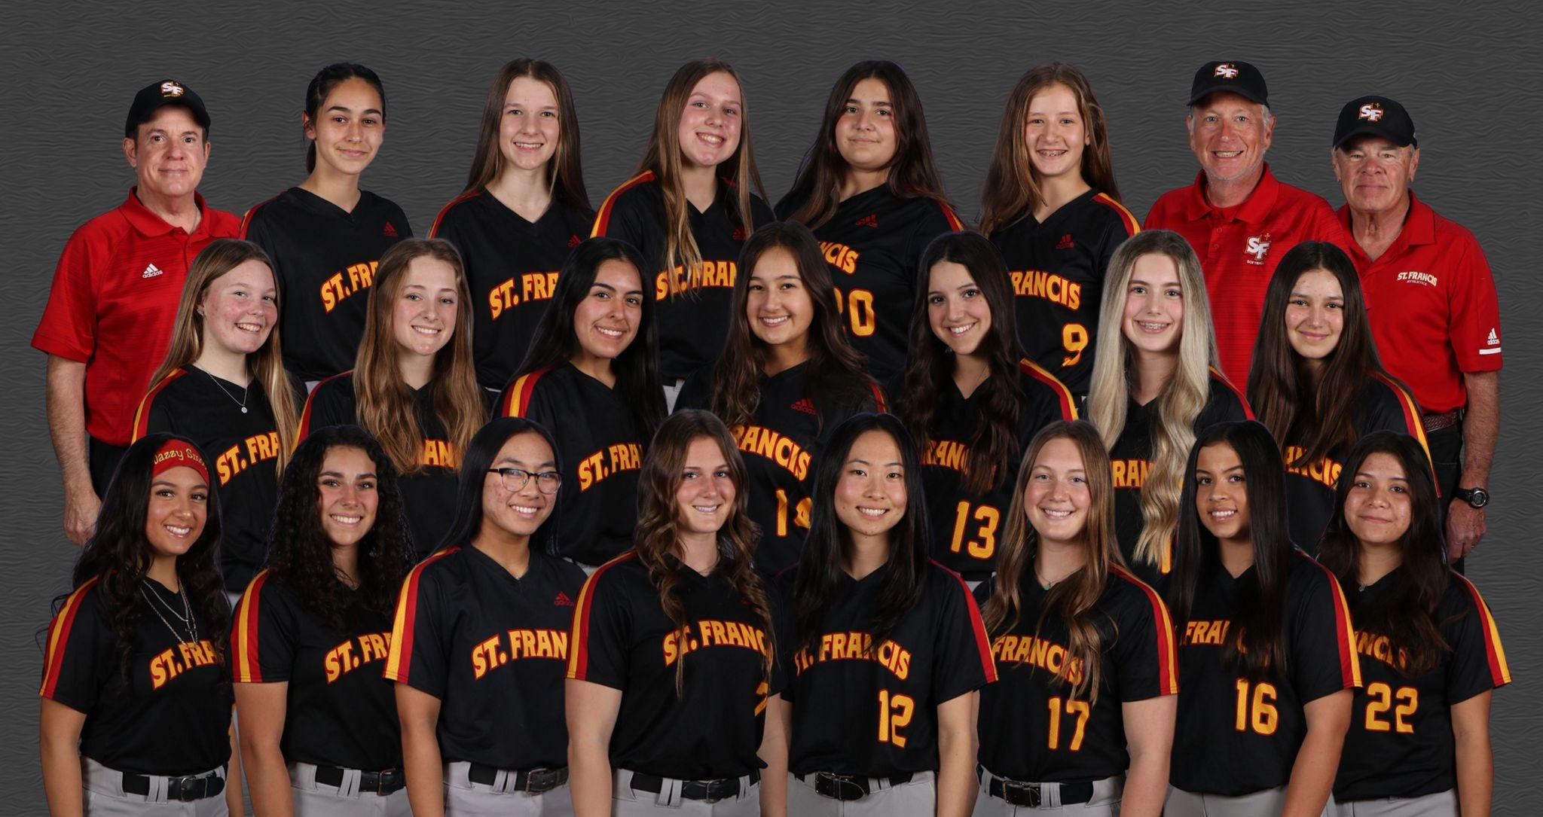
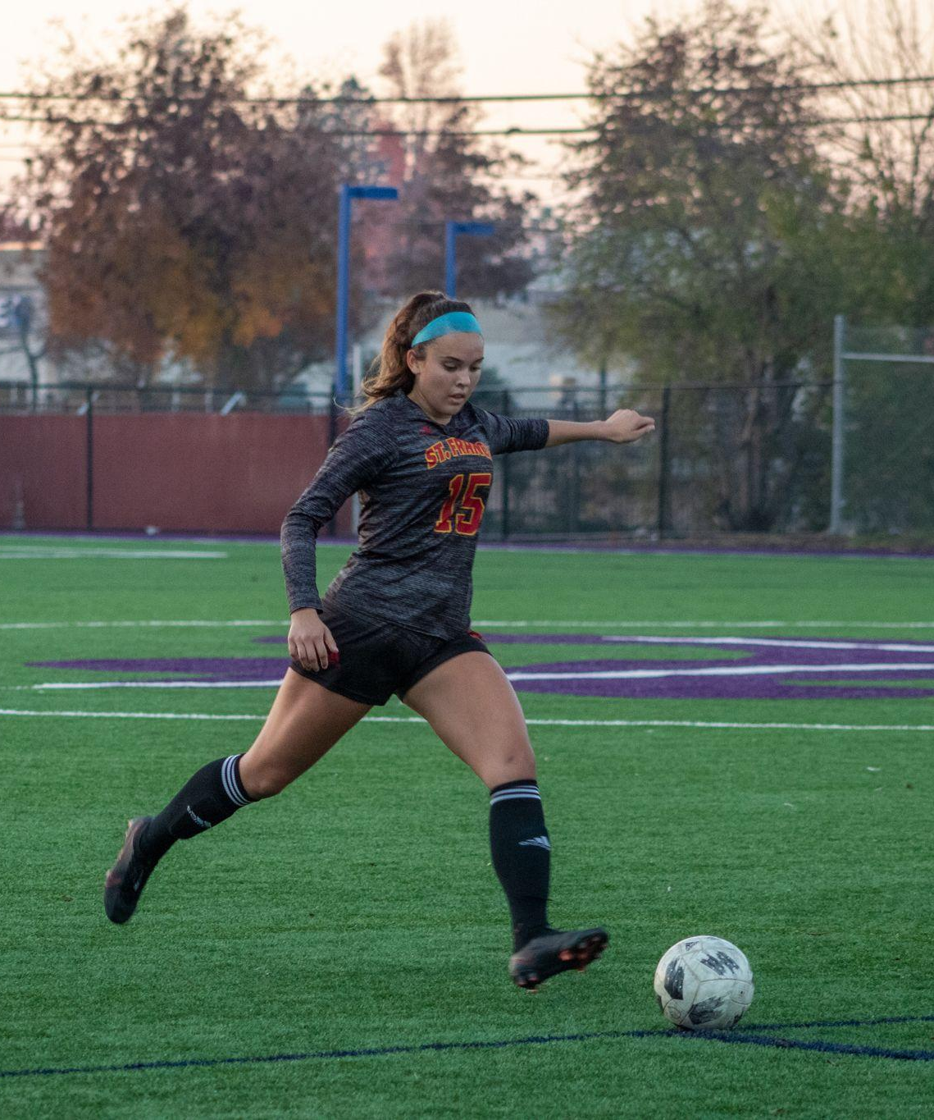
SF ATHLETICS
12 different sports
26 teams & many of them are non-cut

Slide 14
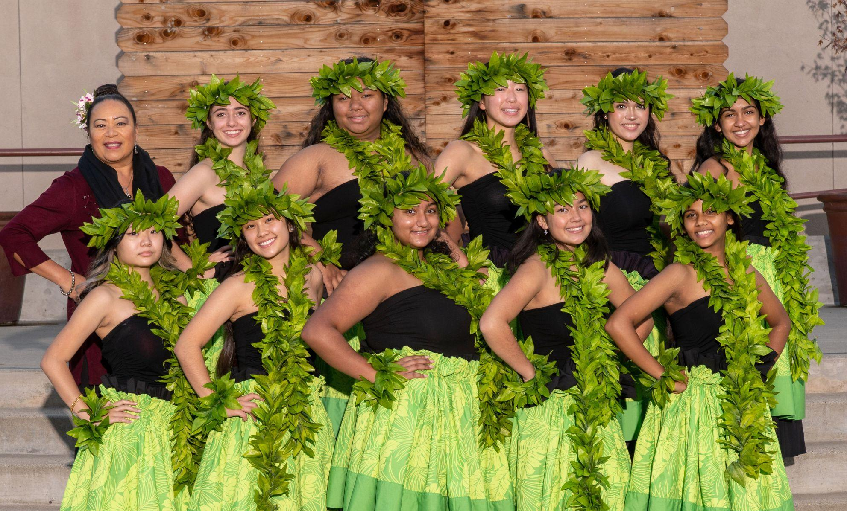
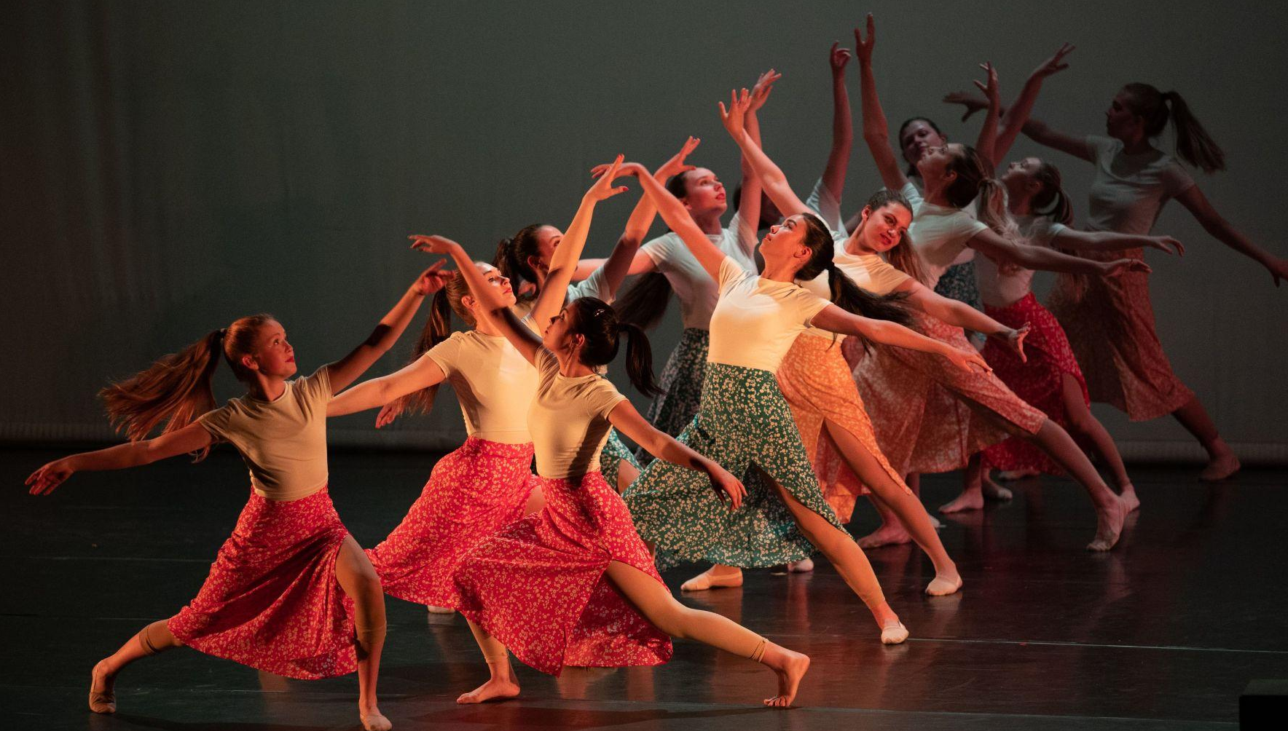
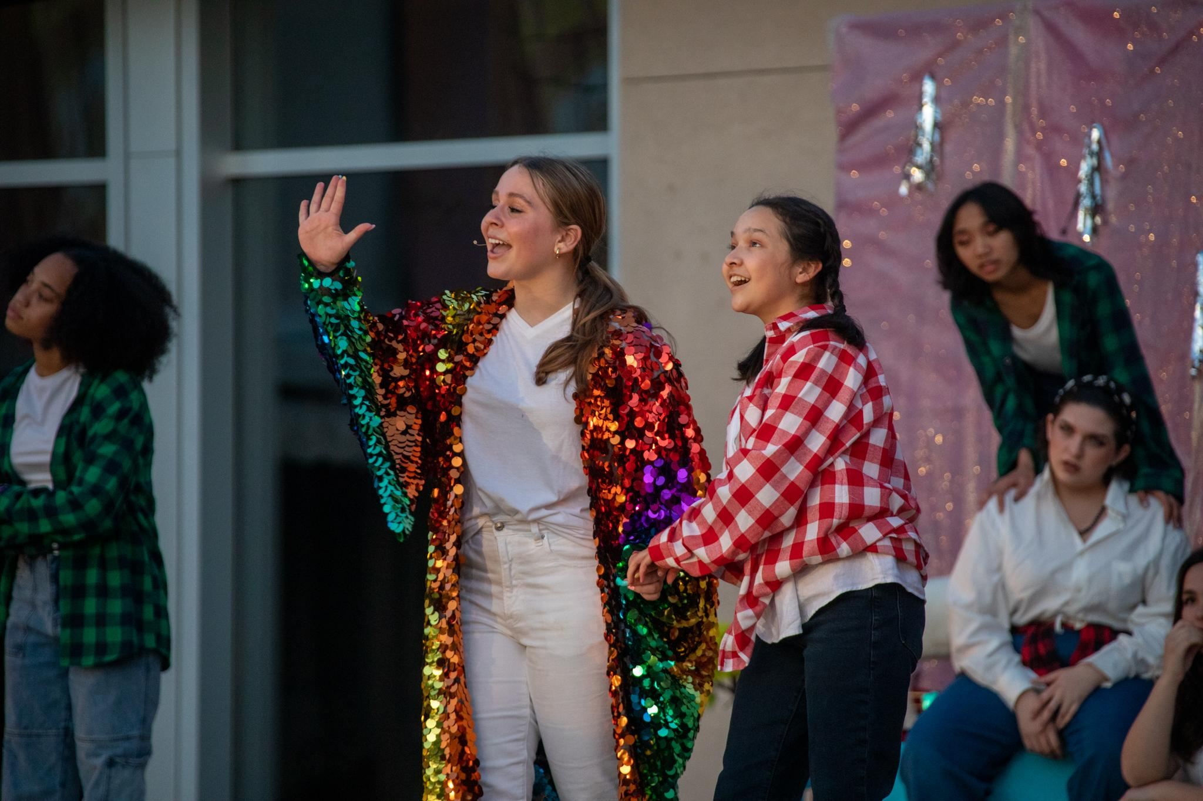
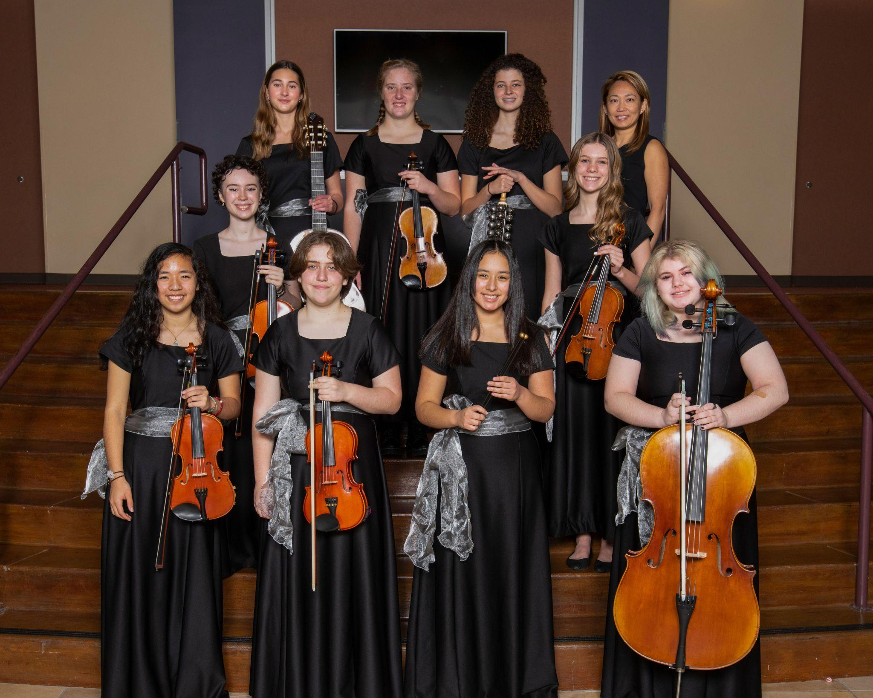
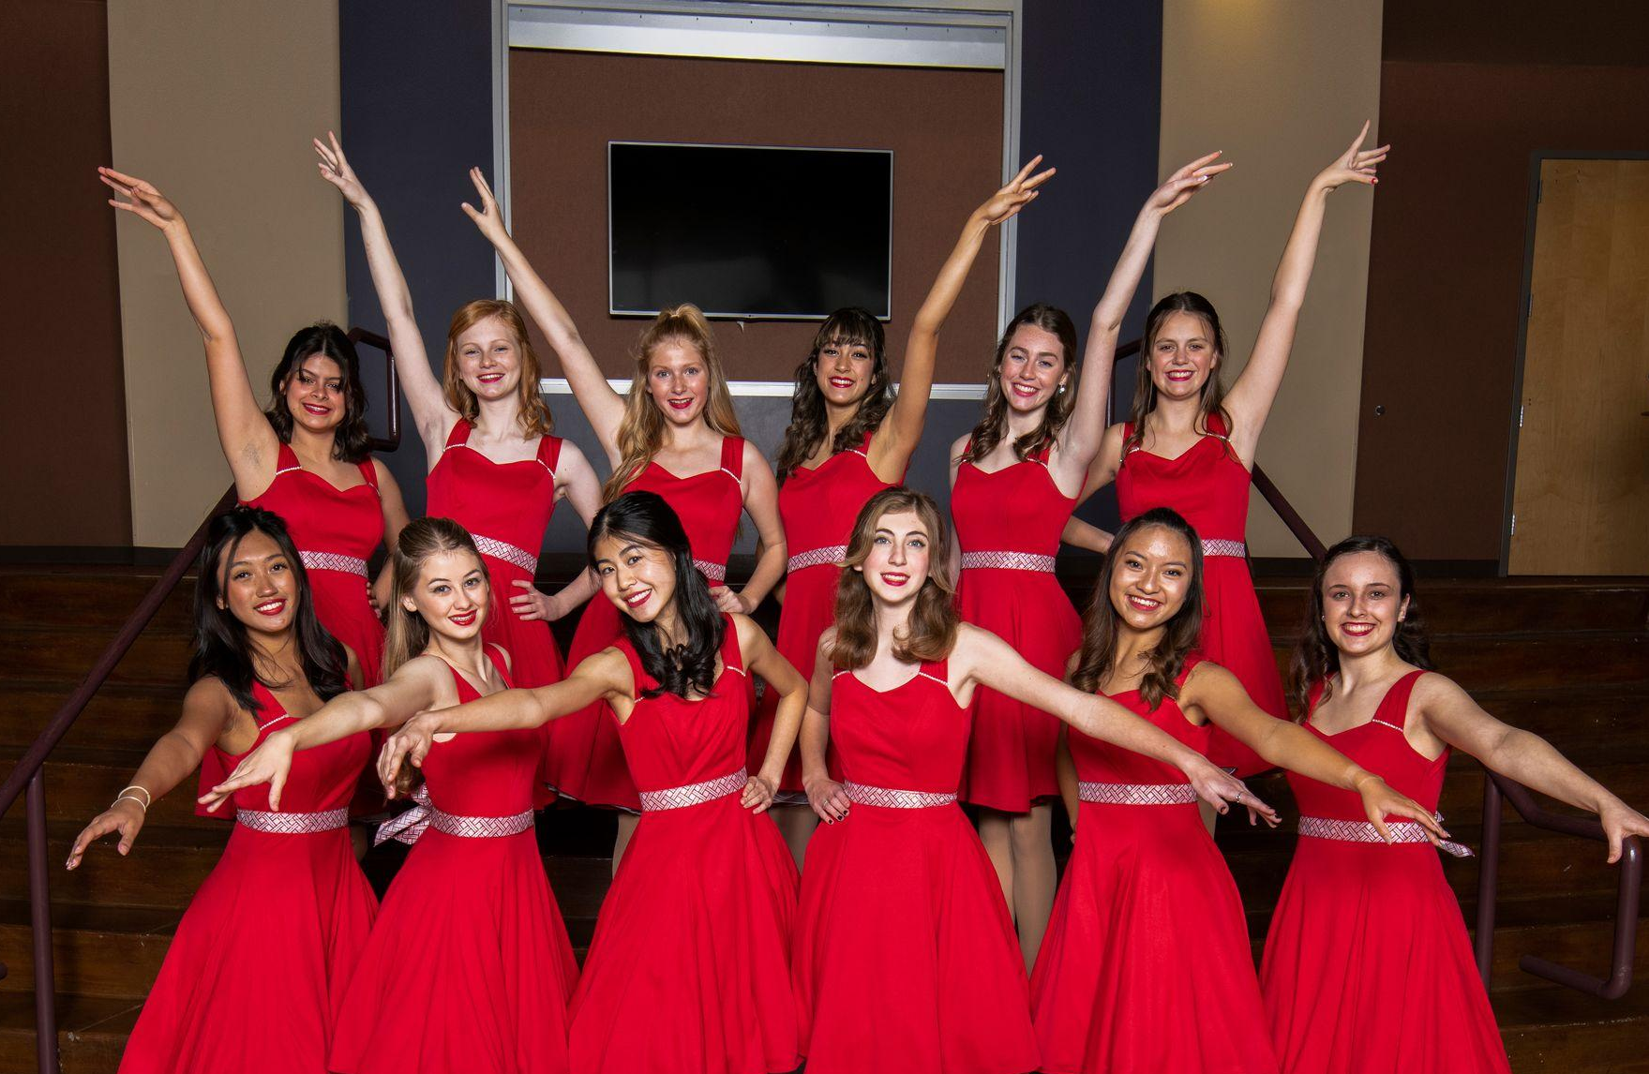
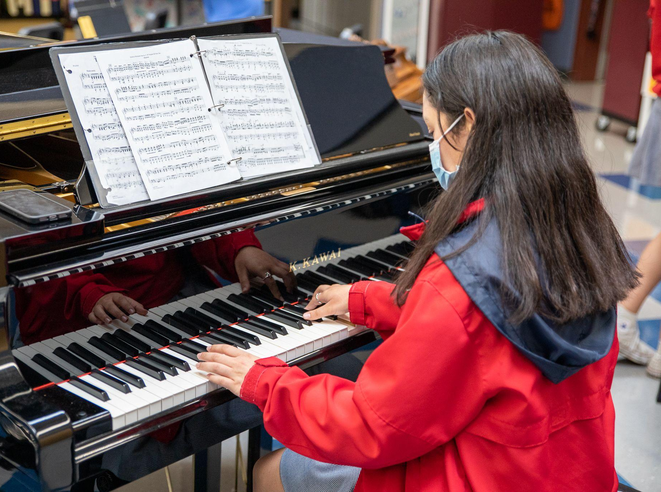
THE ARTS
Dance
Hula & ERA
Orchestra
Choir
Show choir
Theater
Technical Theater
Photography
Painting
Sculpture
Drawing
Digital Film & Animation

Slide 15
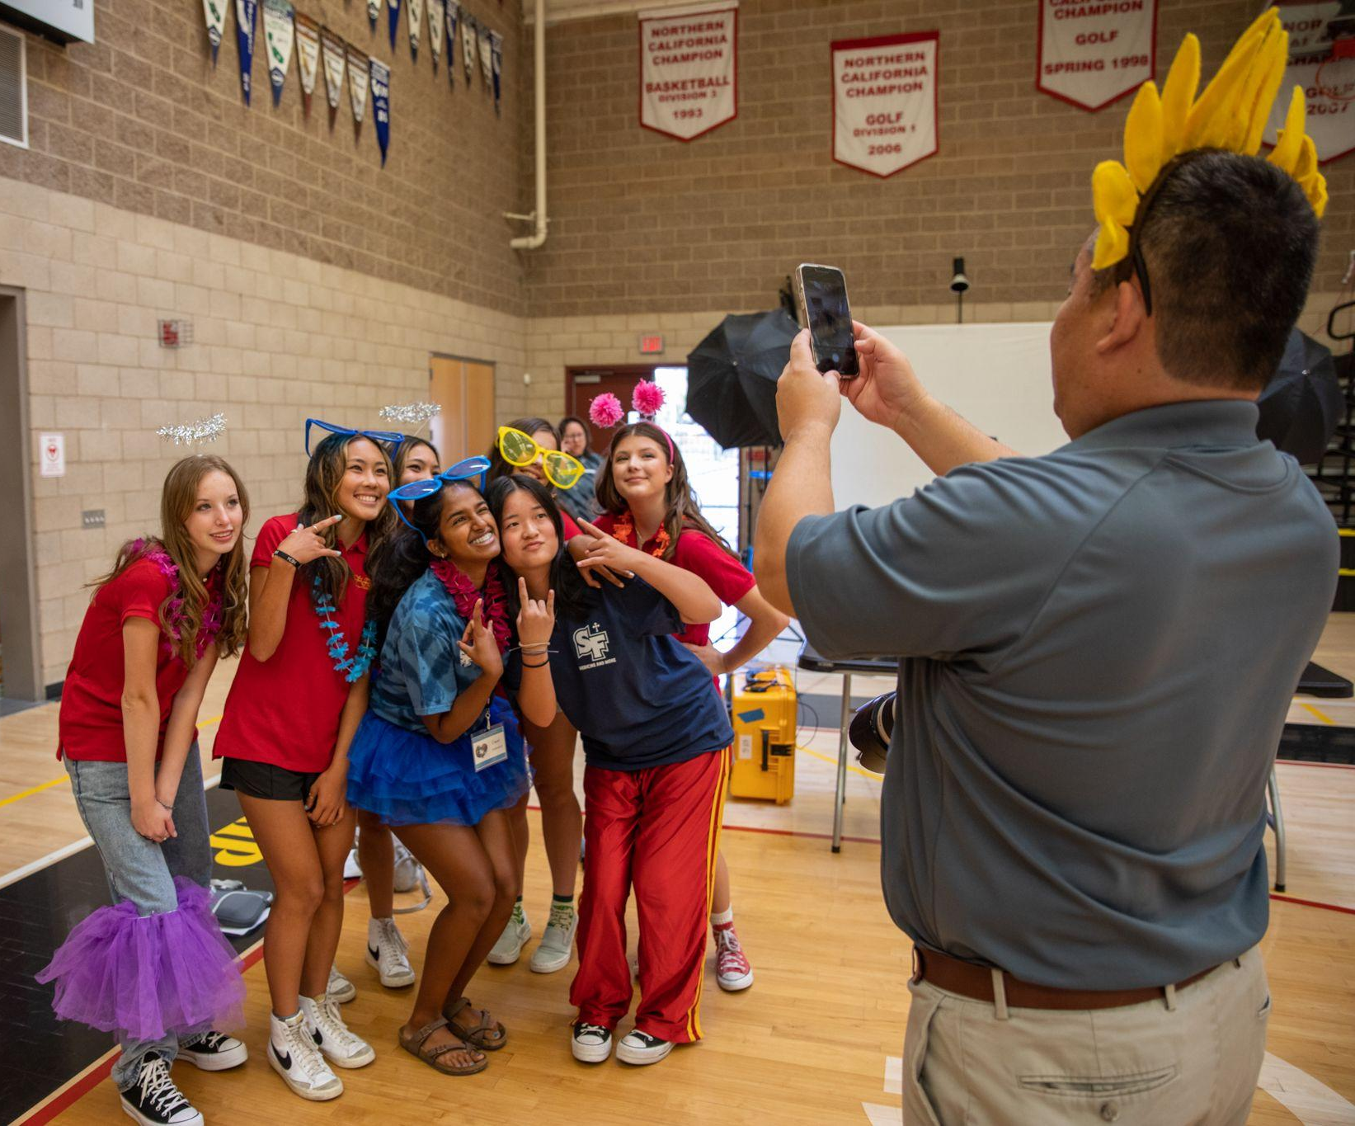
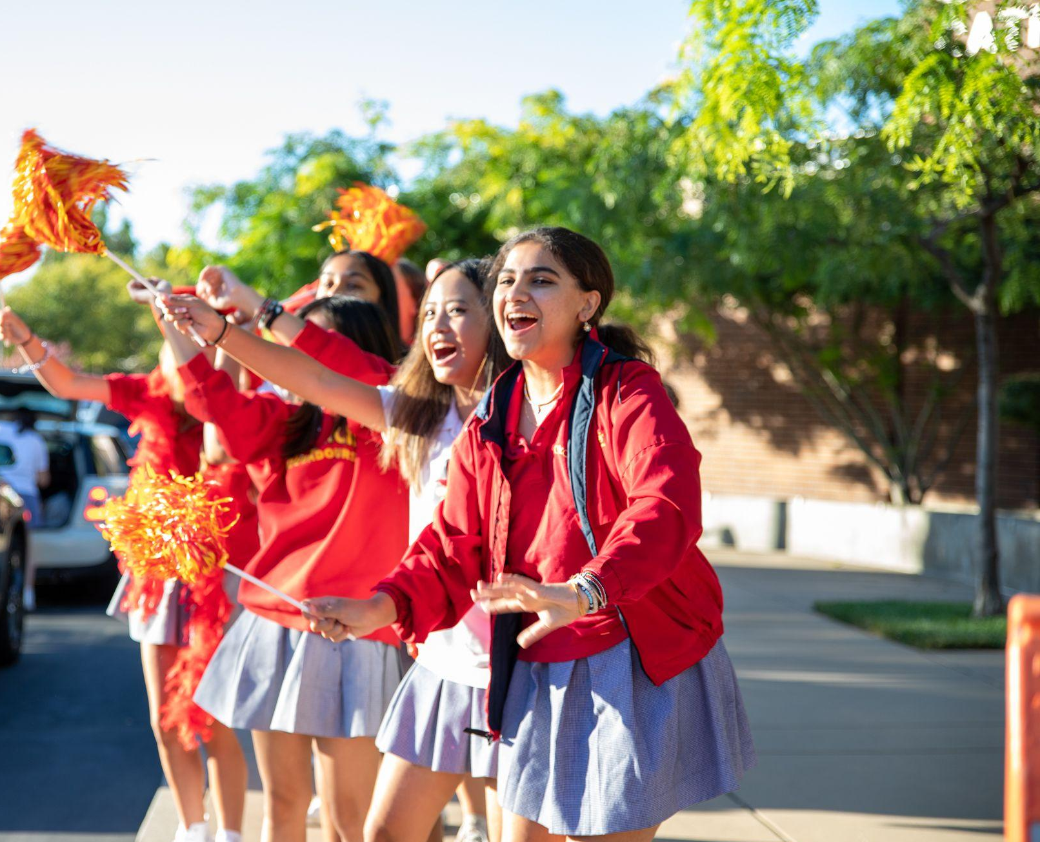
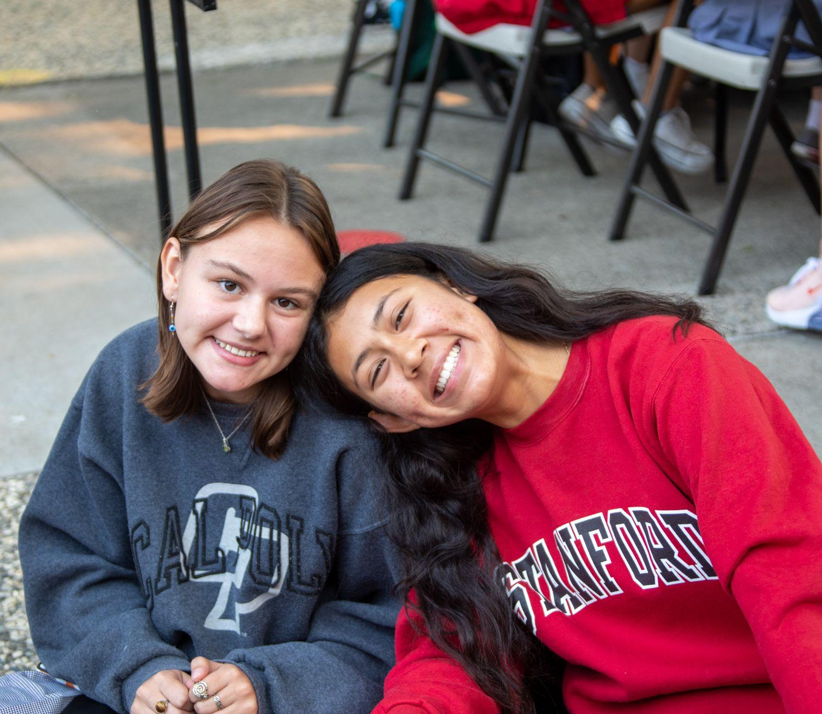
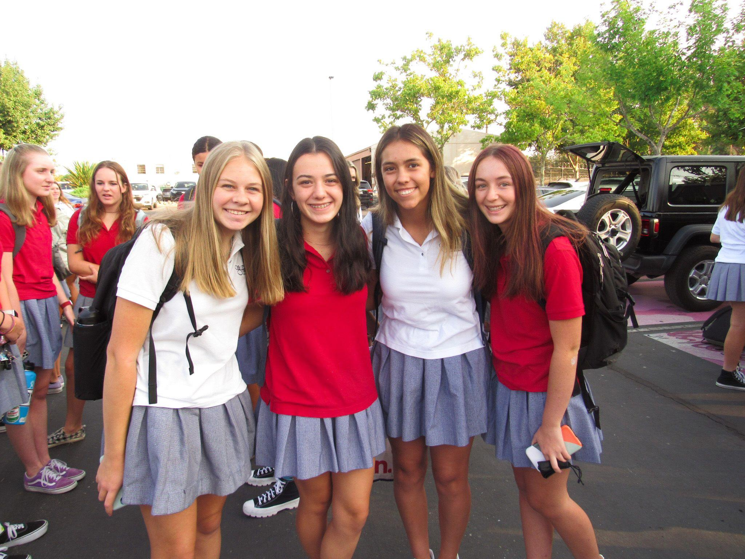
UNIFORM 'FIT
Add your own own style
Fun socks
Jewelry
Nail Polish
Any shoes that have a back
Any SF shirt on Fridays!

Slide 16
TROUBIE
TRIVIA

Slide 17
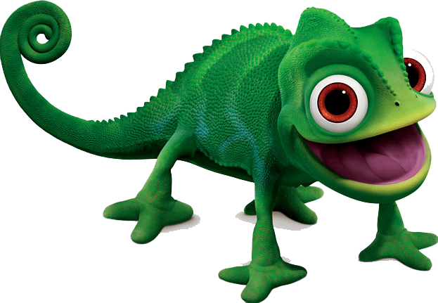
What are the 4 current class mascots?

Slide 18
Name a Homecoming
Class theme option
HOMECOMING

Slide 19
What happens on
SWAP DAY ?

Slide 20
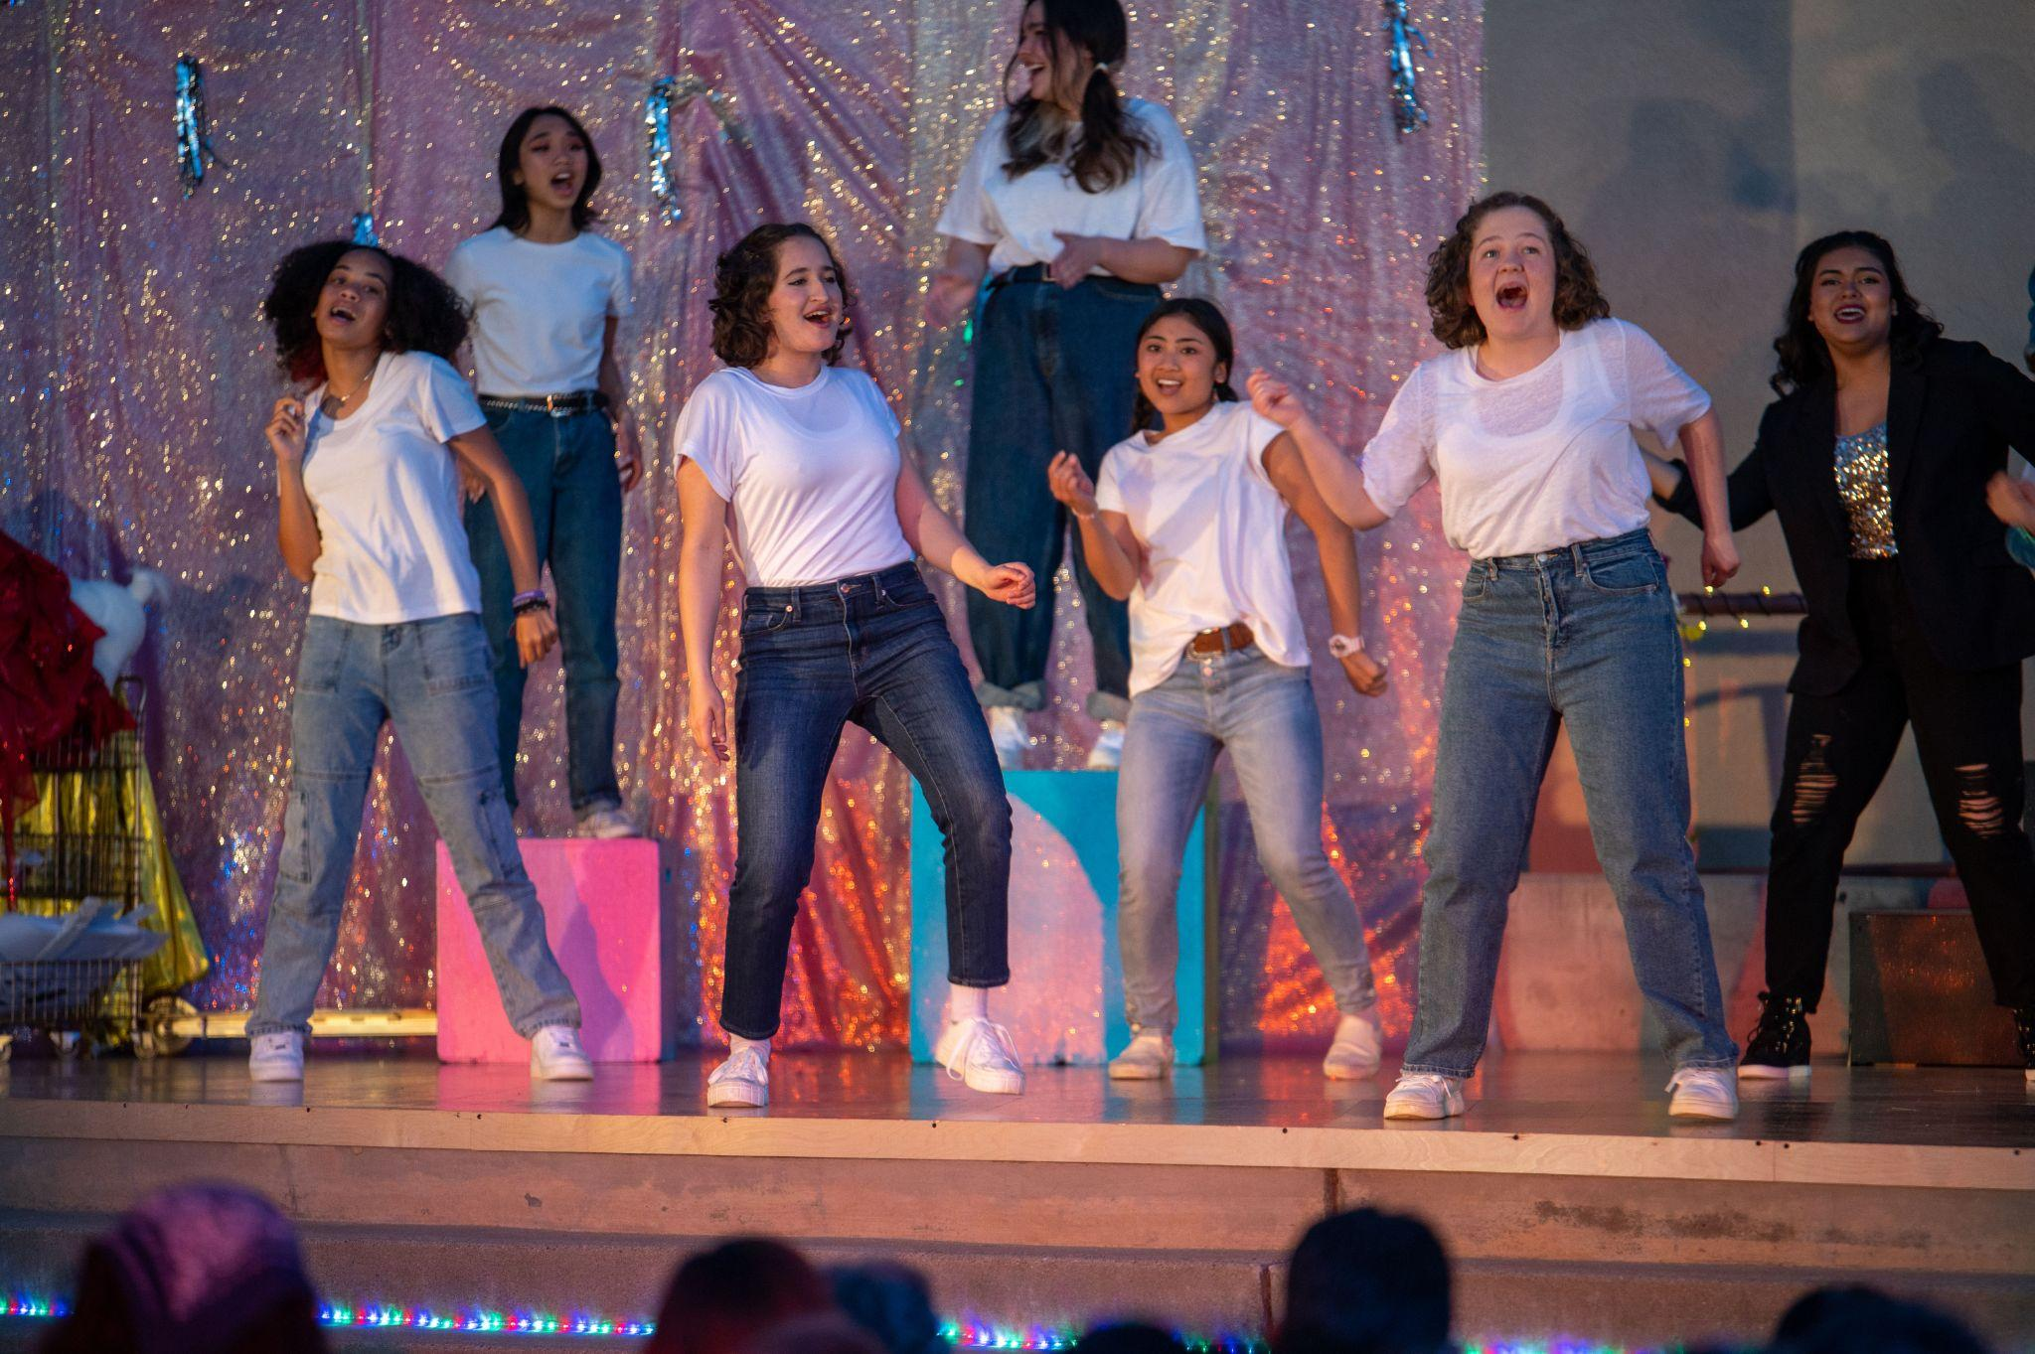
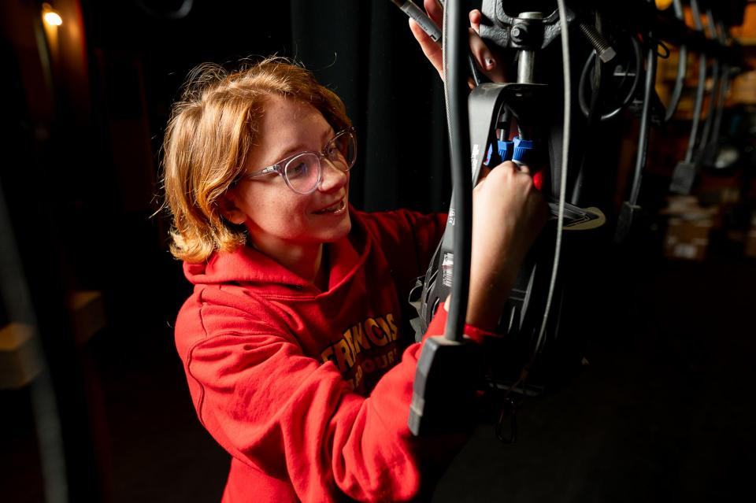
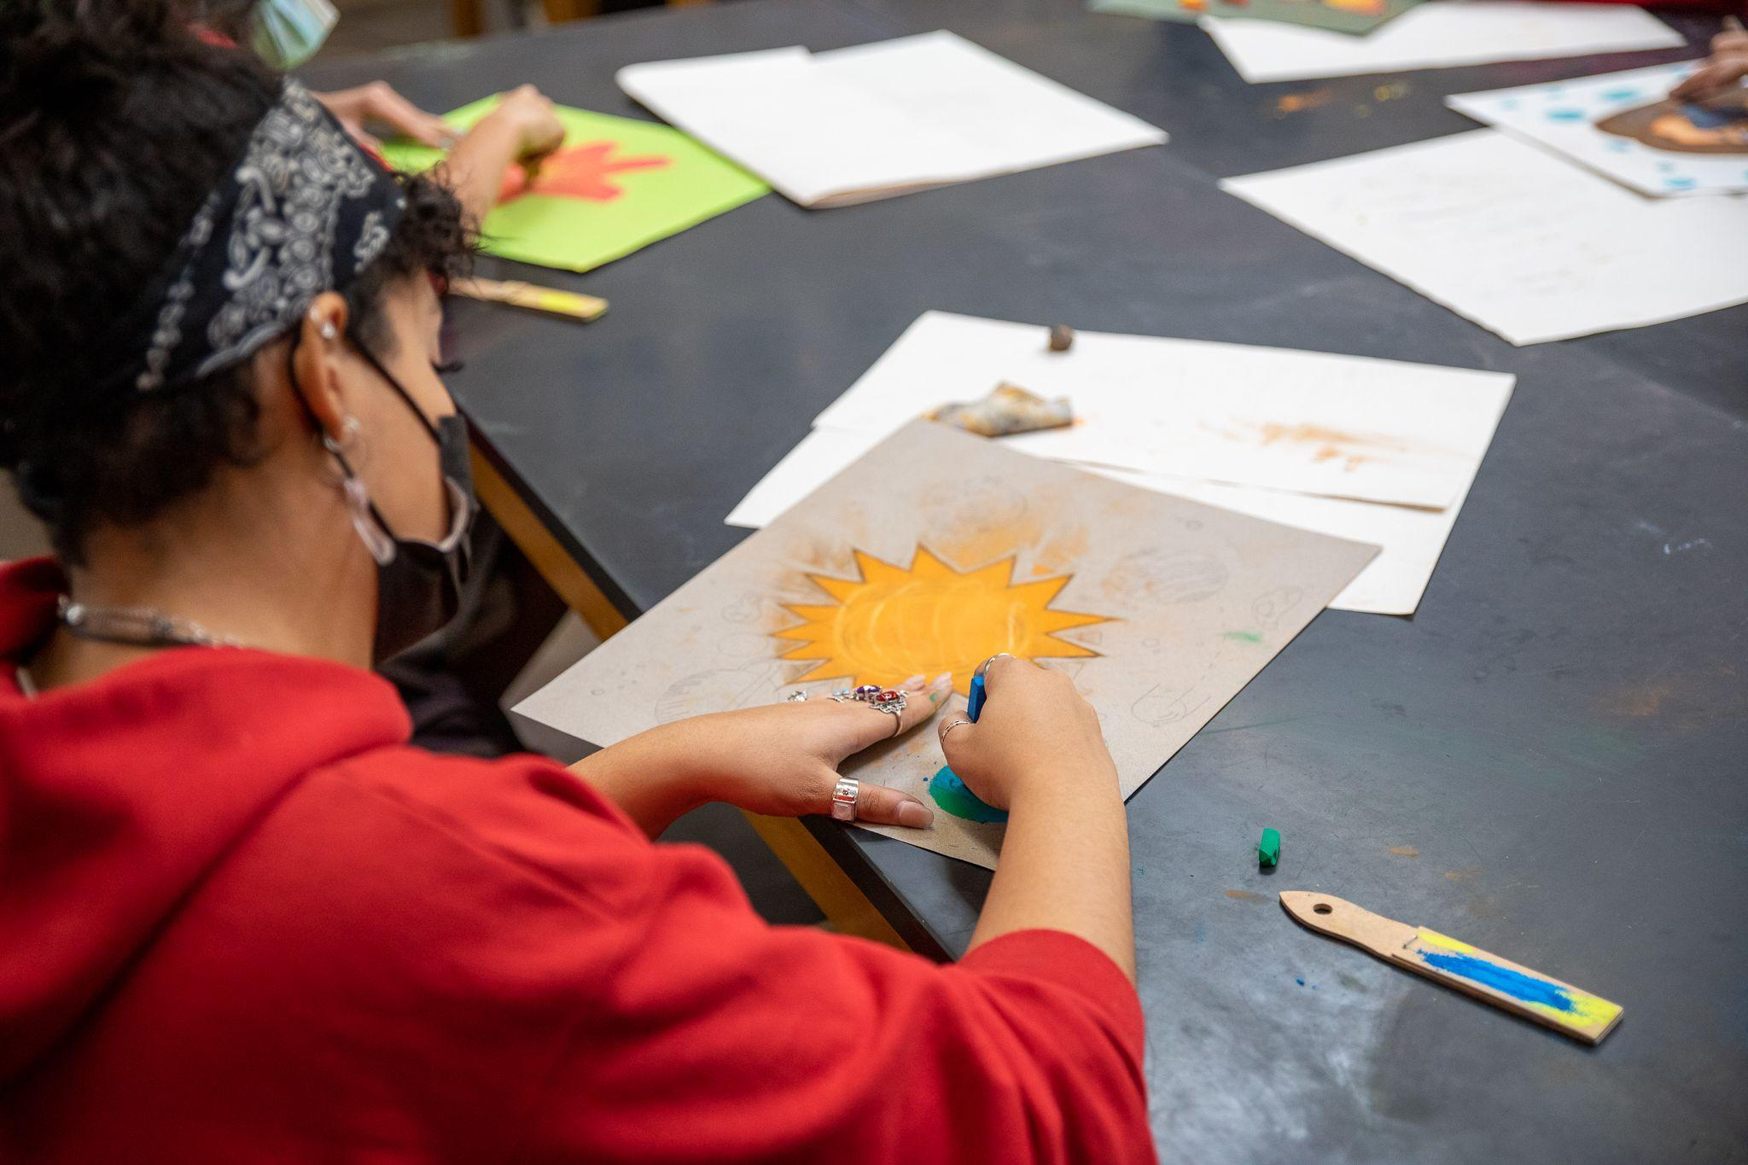
Write down as many SF visual and performing arts options as you can!

Slide 21
FREEDOM
TO BE YOURSELF AND CHOOSE YOUR PATH!

Slide 22
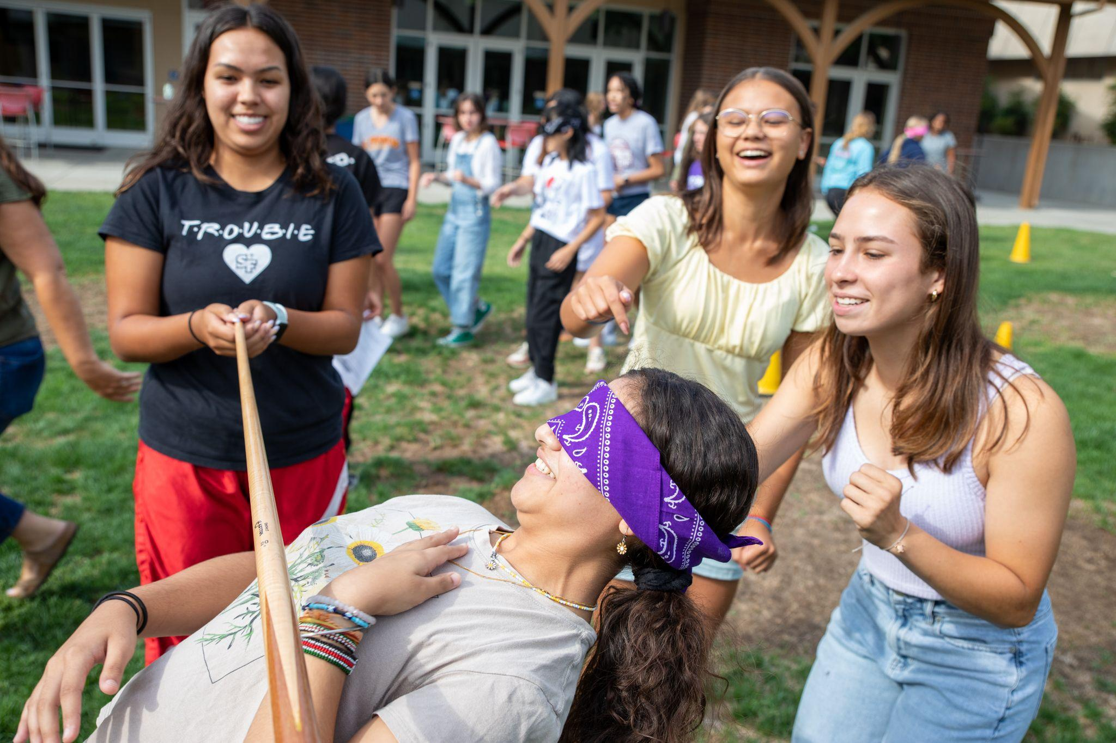
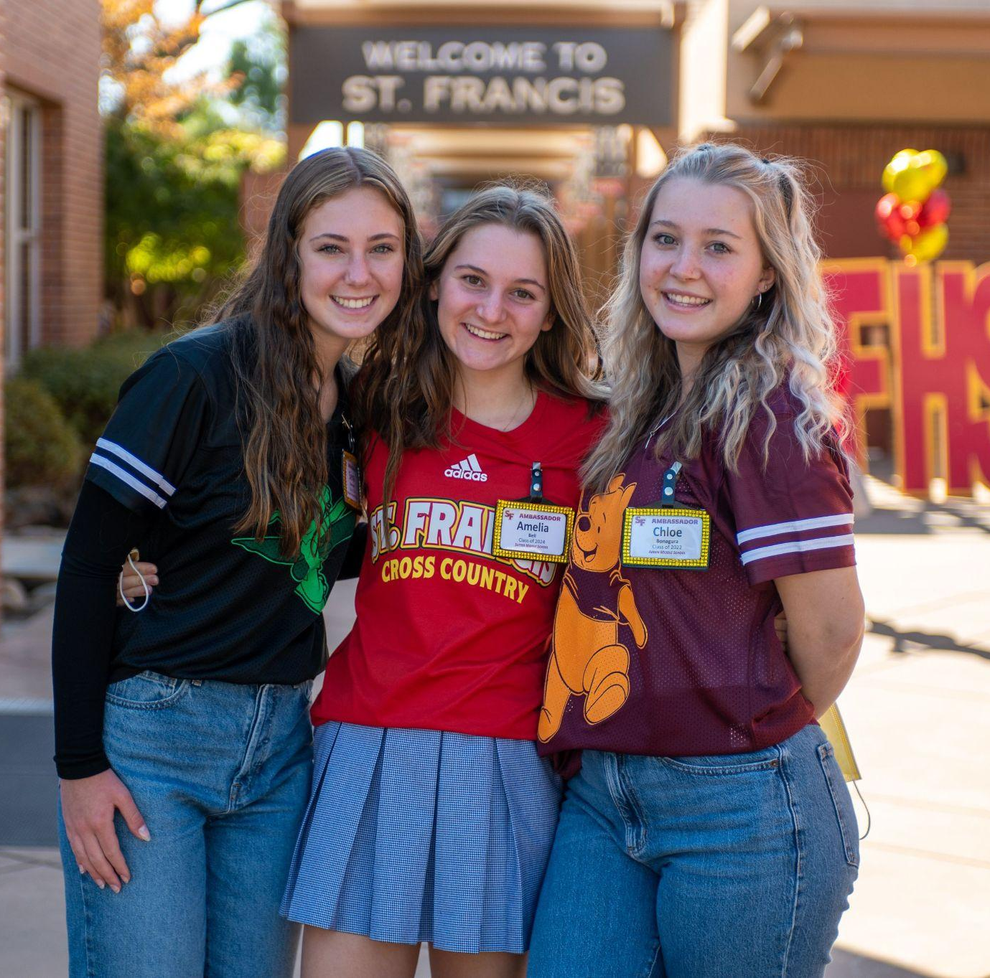
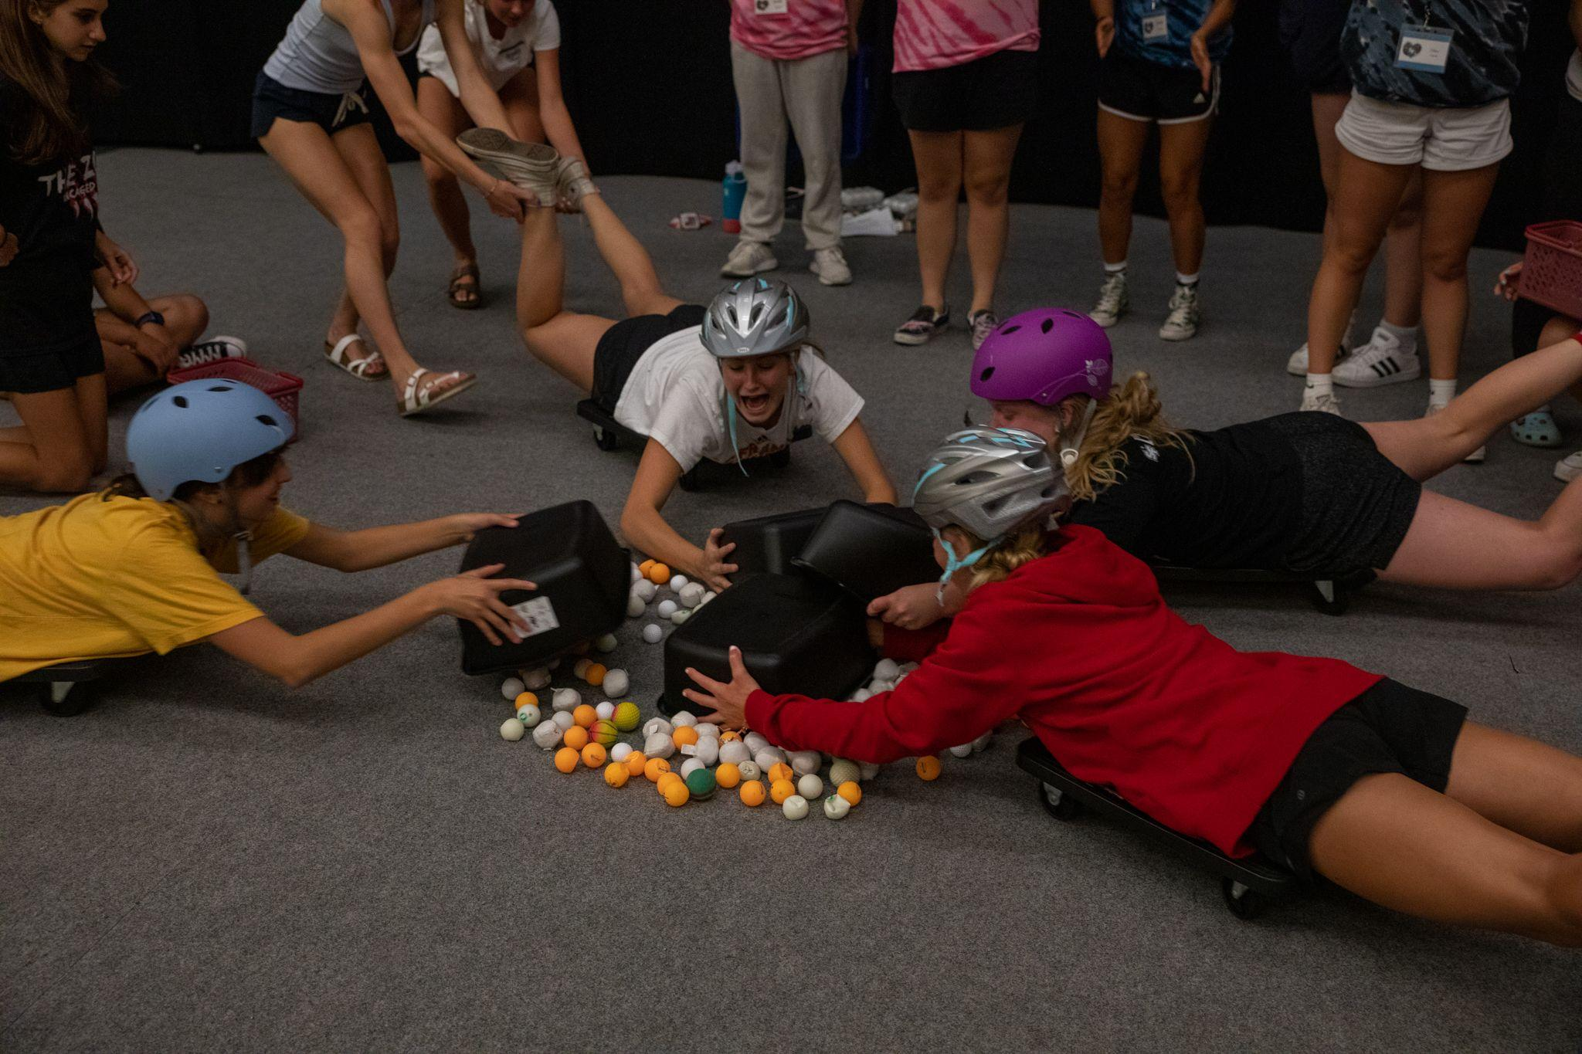
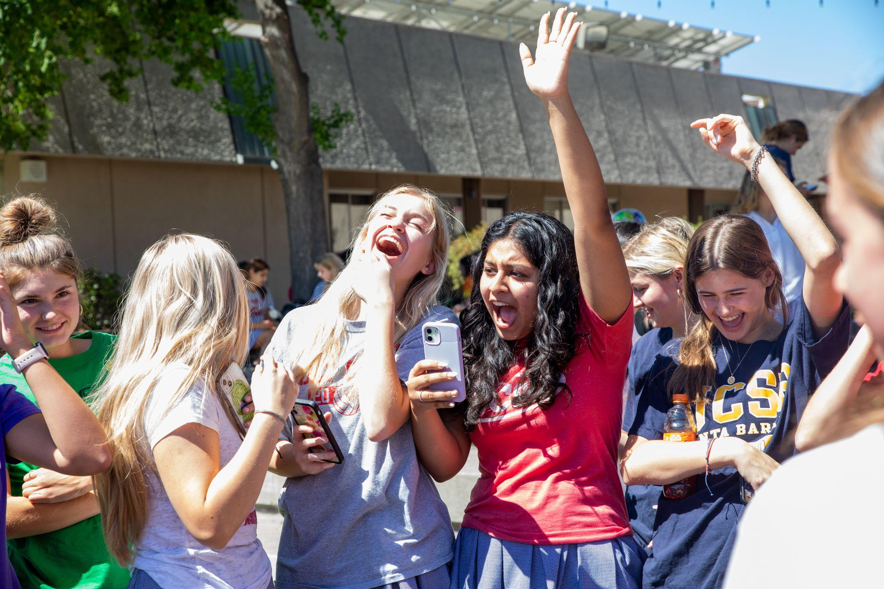
BELONGING
Being YOURSELF
Girls in single gender classrooms report feeling more comfortable being themselves and expressing their ideas.

Slide 23
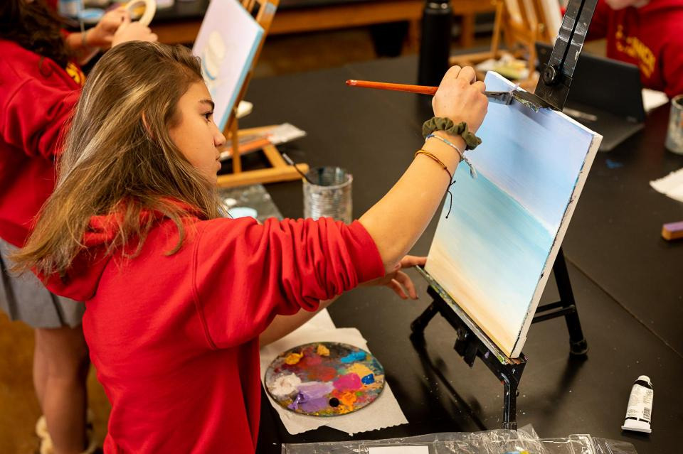
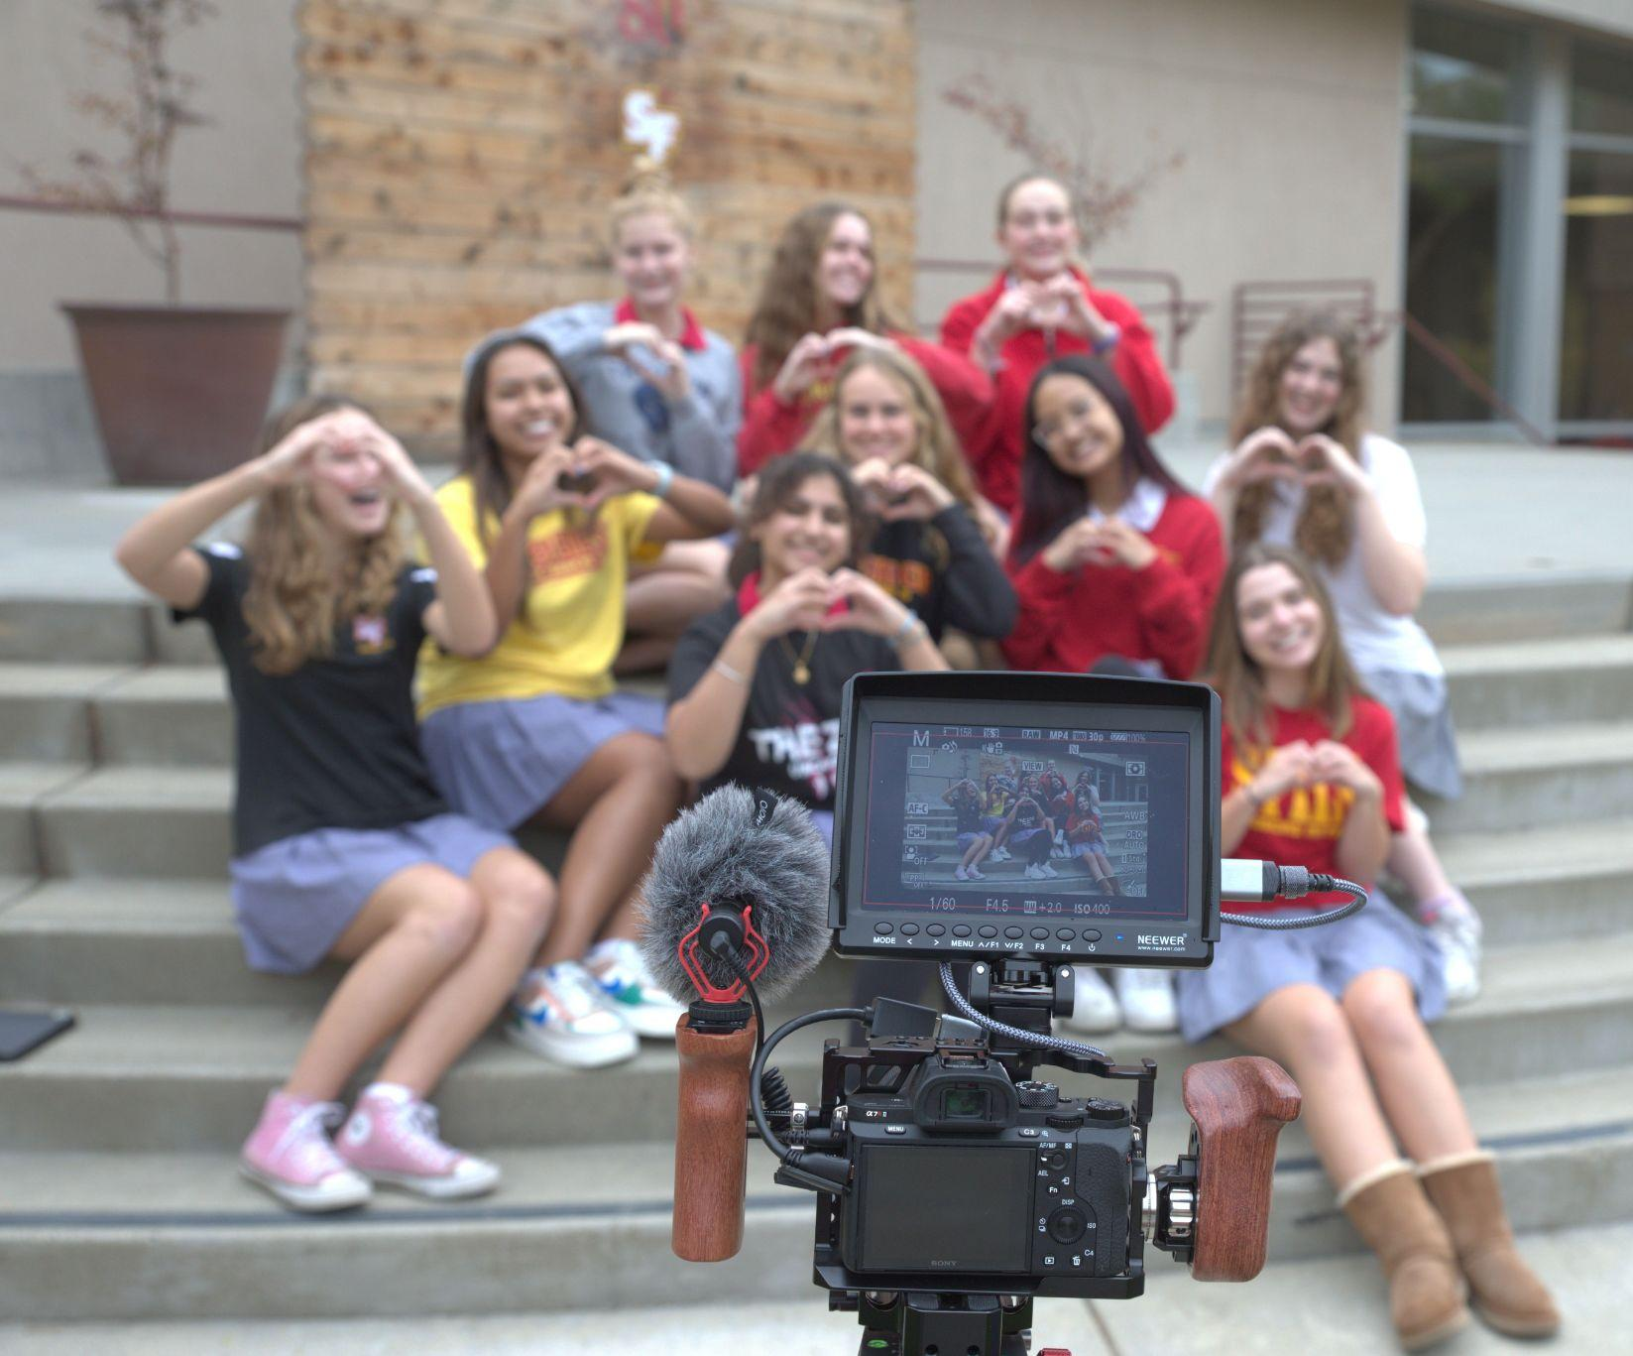
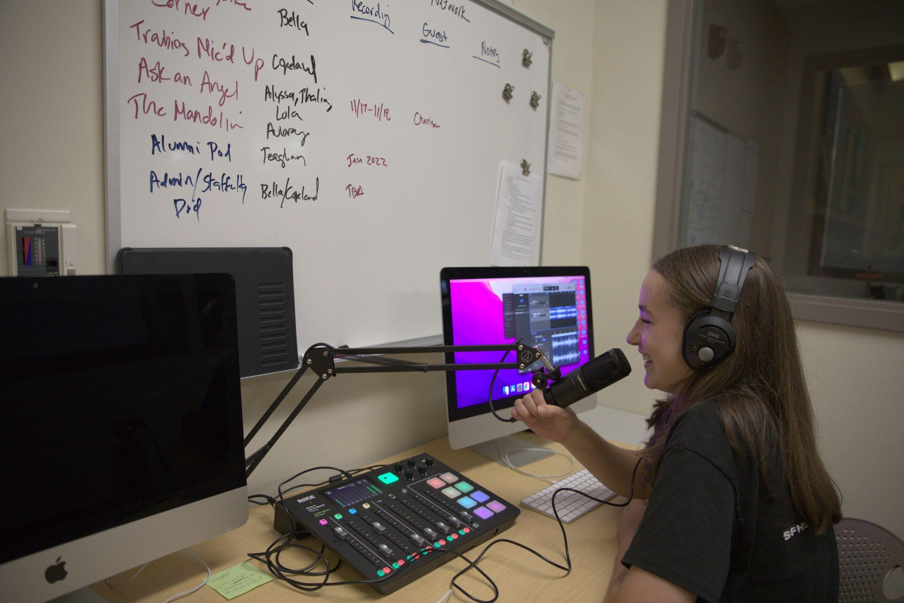
EXPLORING INTERESTS
Electives
Computer Science
Photography
Arts
Troubie TV
Four Foreign Languages offered
Free block in your schedule

Slide 24
CLUBS & ACADEMIC TEAMS
There are over 80 different ways to meet new friends and find new passions!
We also have 9 academic teams.

Slide 25
FUTURE
IT’S A BRIGHT ONE AT ST. FRANCIS!

Slide 26
ACADEMICS
We offer 35 Honors and AP Classes
Each student is assigned an academic counselor and a college counselor to help find the best college fit for her

Slide 27
COME & EXPERIENCE SFHS AT
Sunday, October 9, 2022
12:00 pm - 3:00 pm
OPEN HOUSE

