Slide 1
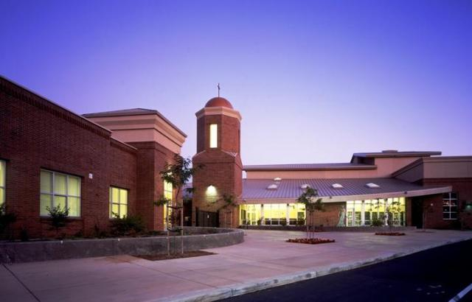
St. Francis High School
Westlake Charter School High School Preview Night

Slide 2
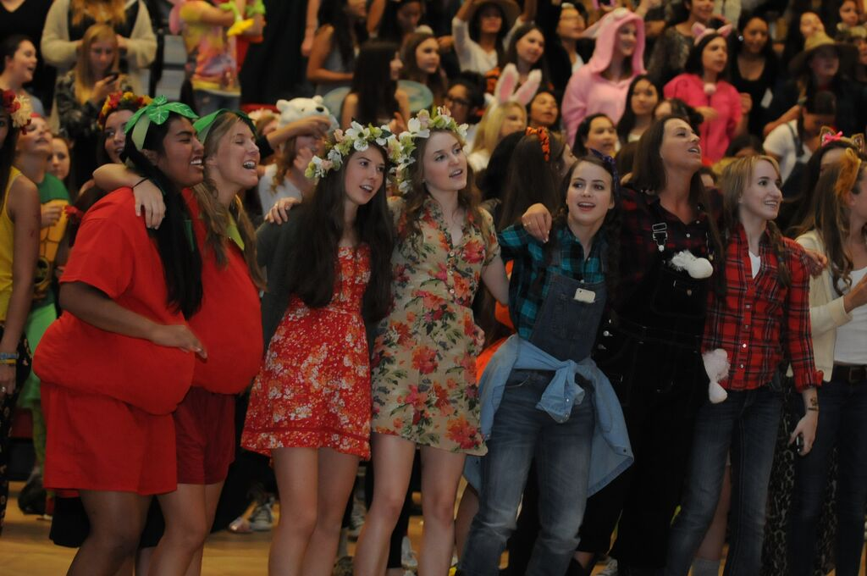
Four Years That
Last a Lifetime

Slide 3
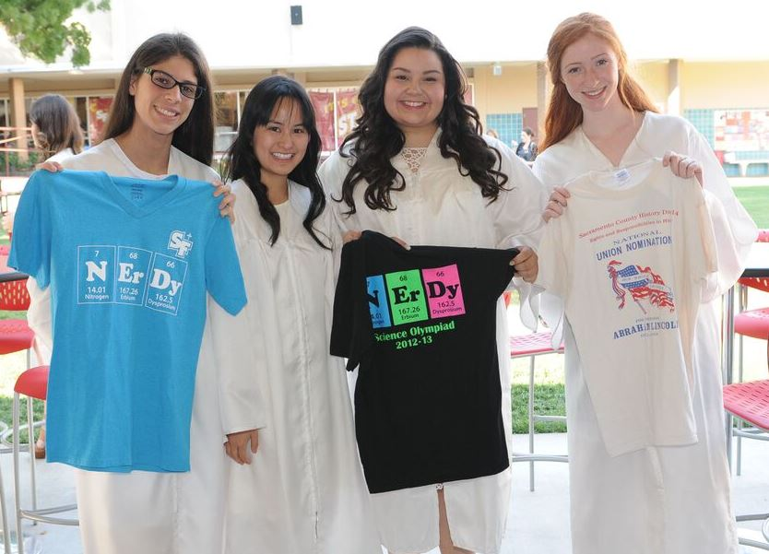
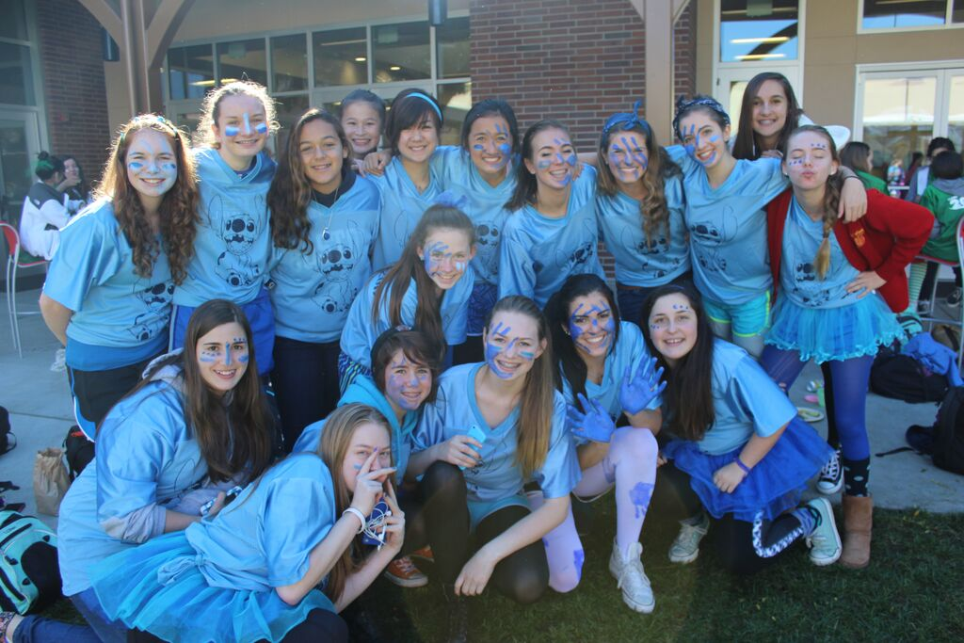
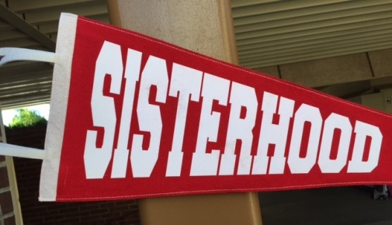
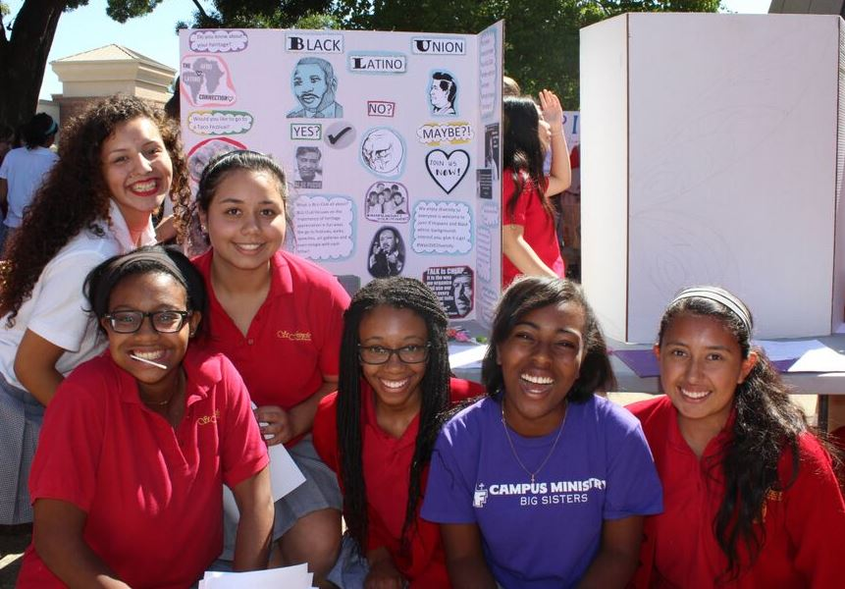
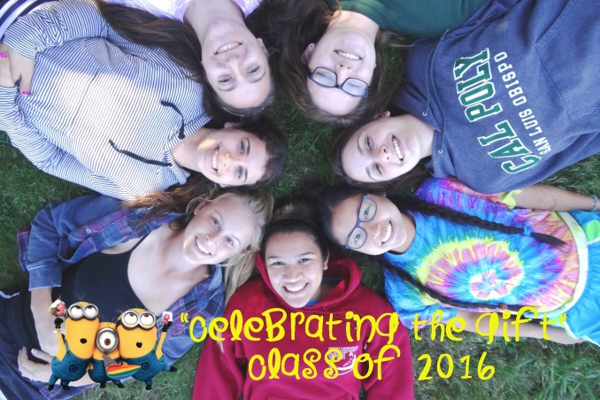

Community
Notes:
Retreats, Service, SISTERHOOD, discover your gifts and talents, Community of Faith

Slide 4
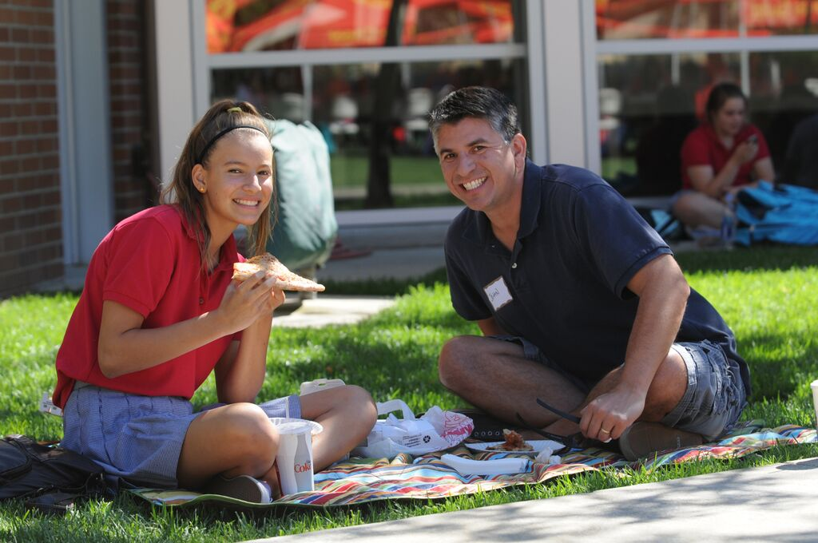
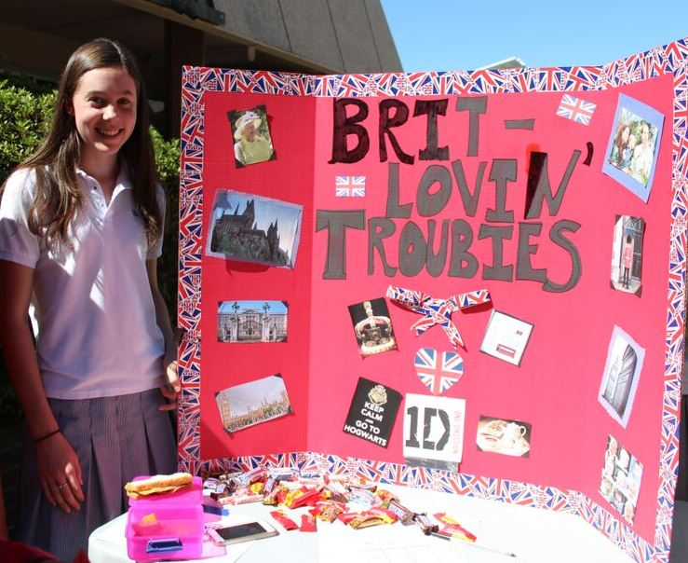
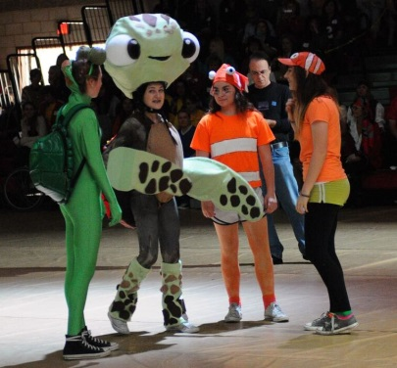
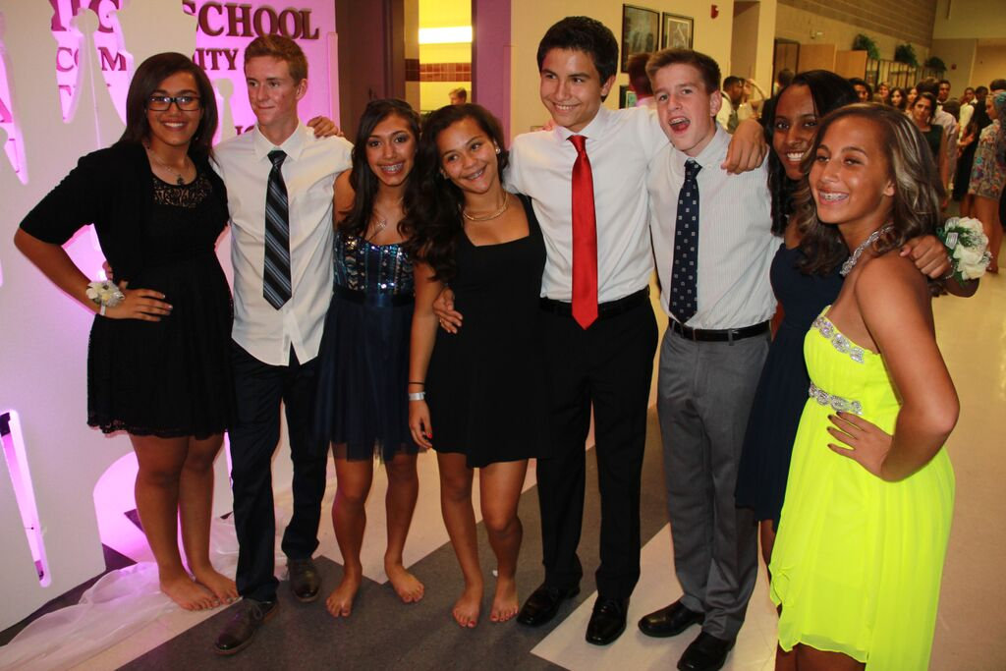
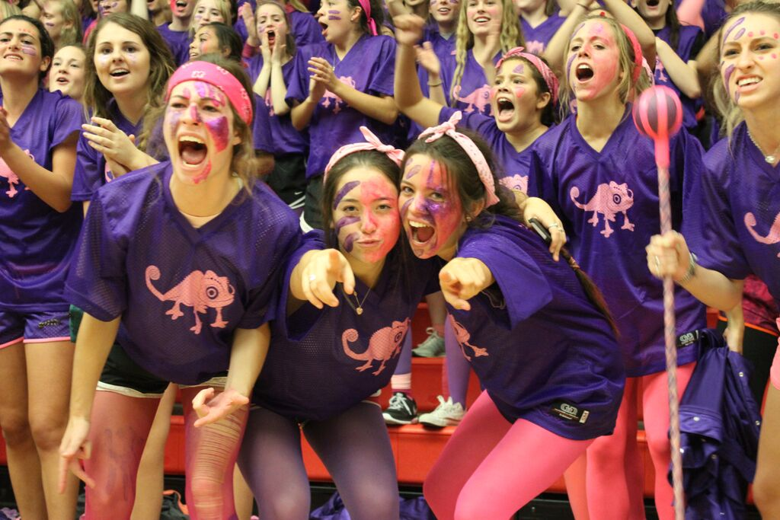
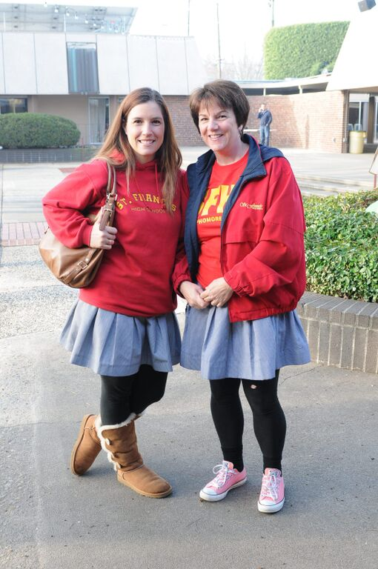
Tradition
Notes:
Coed dances, SWAP Day, we want parents on campus!

Slide 5
The All-Girls Advantage
80% of graduates of all-girls schools held leadership positions after high school.
Nearly three-fourths of girls’ school grads consider college a stepping stone to graduate school, and they are more than twice as likely to earn a doctoral degree.
Graduates of girls’ schools are six times more likely to consider majoring in math, science and technology; they are three times more likely to consider engineering careers.
Girls’ school grads spend more time studying, tutoring other students, and speaking with teachers outside of class.

Slide 6
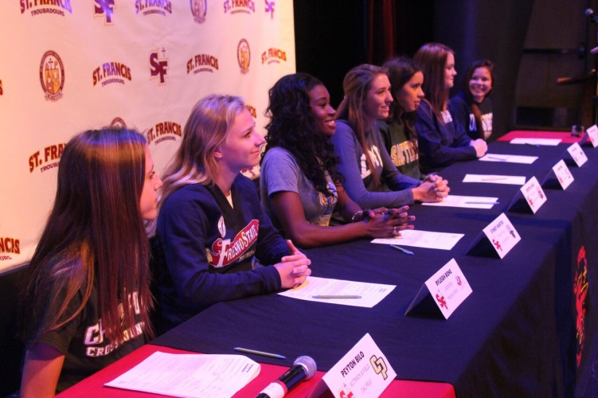
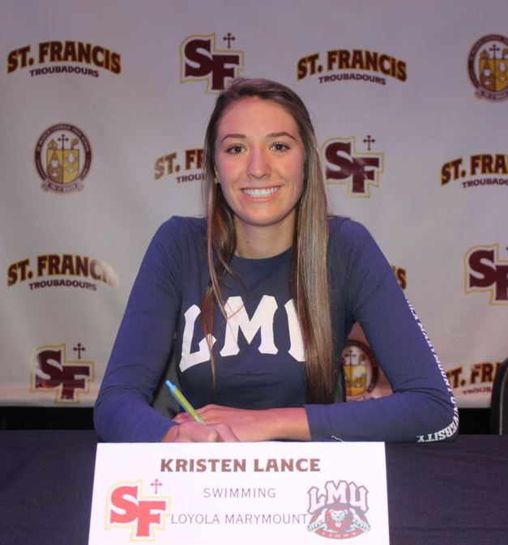
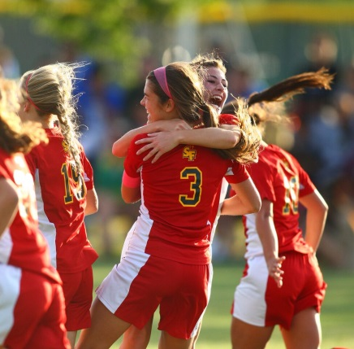
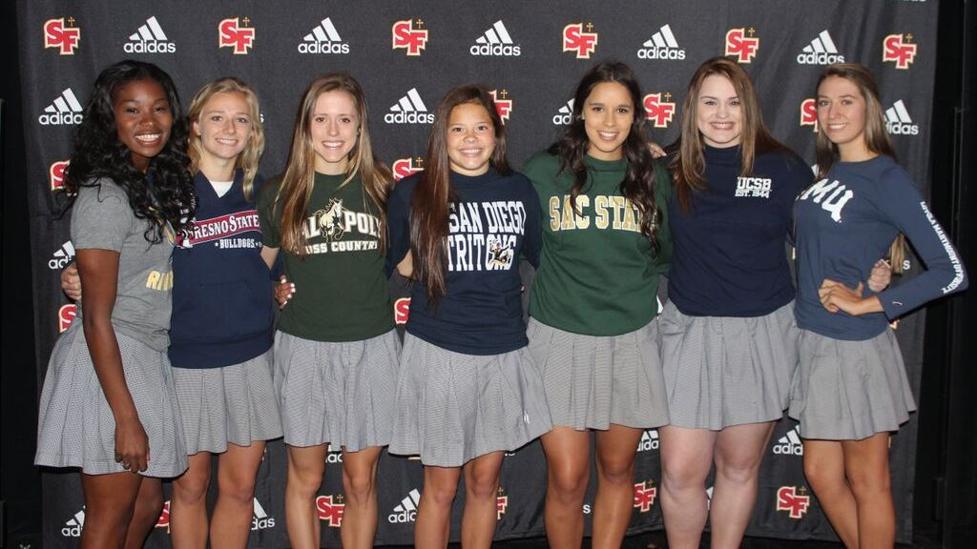
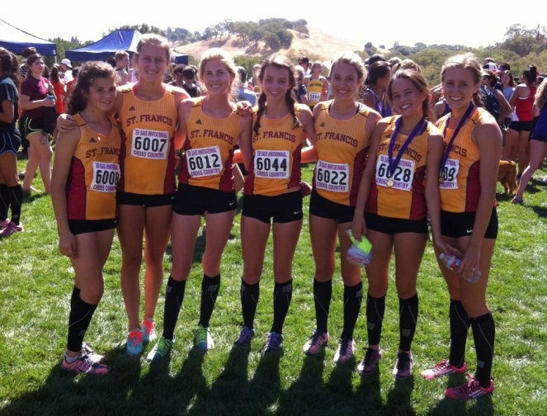
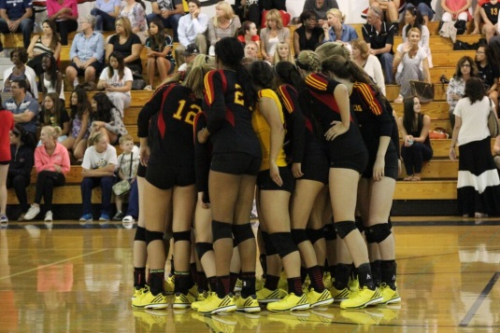

⬇46% of the student body participates in athletics.
⬇SFHS has captured 90 Sac-Joaquin Section titles, more than any other girls’ program.
⬇In the last three years, 79 SFHS students have committed to play collegiate sports.

Slide 7
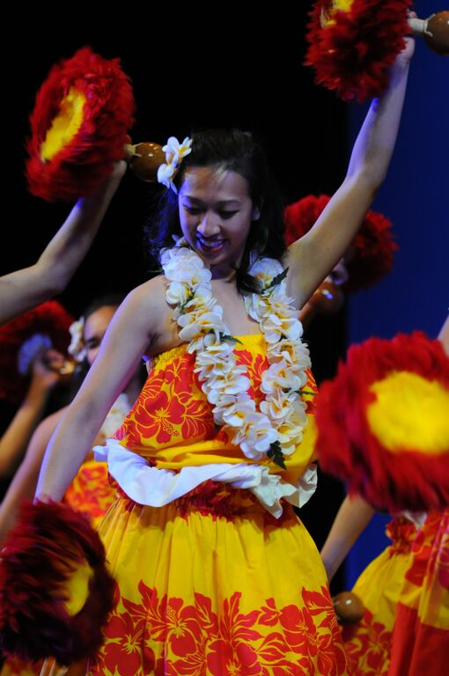
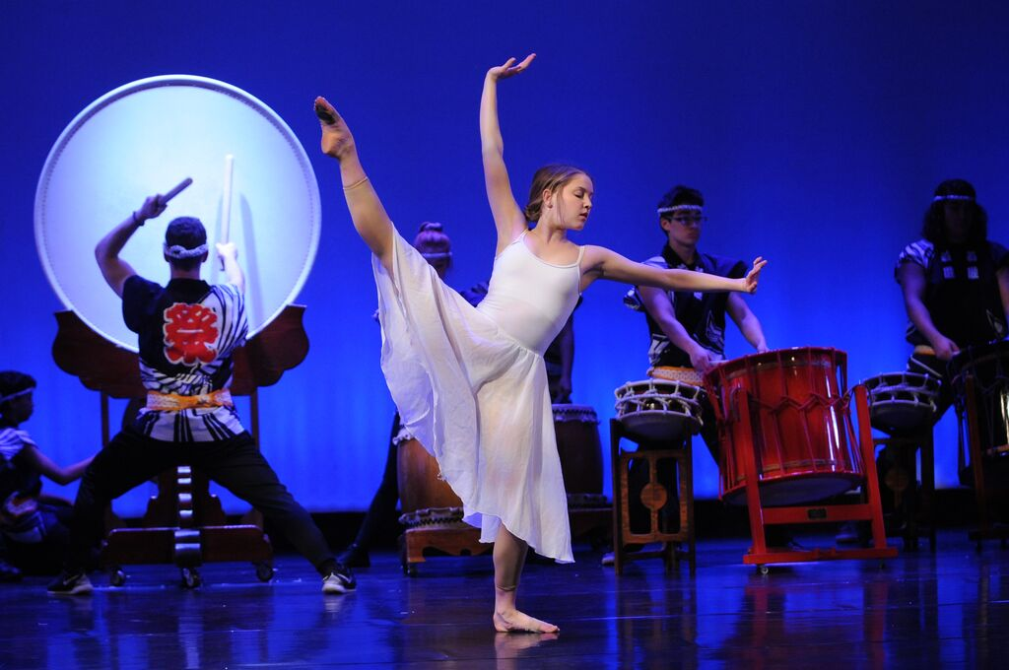

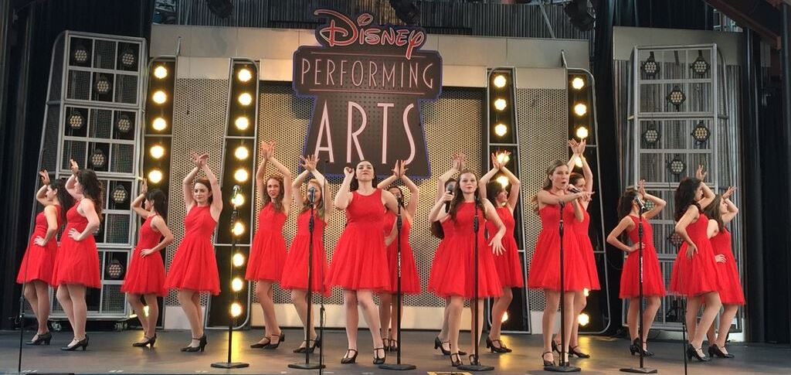
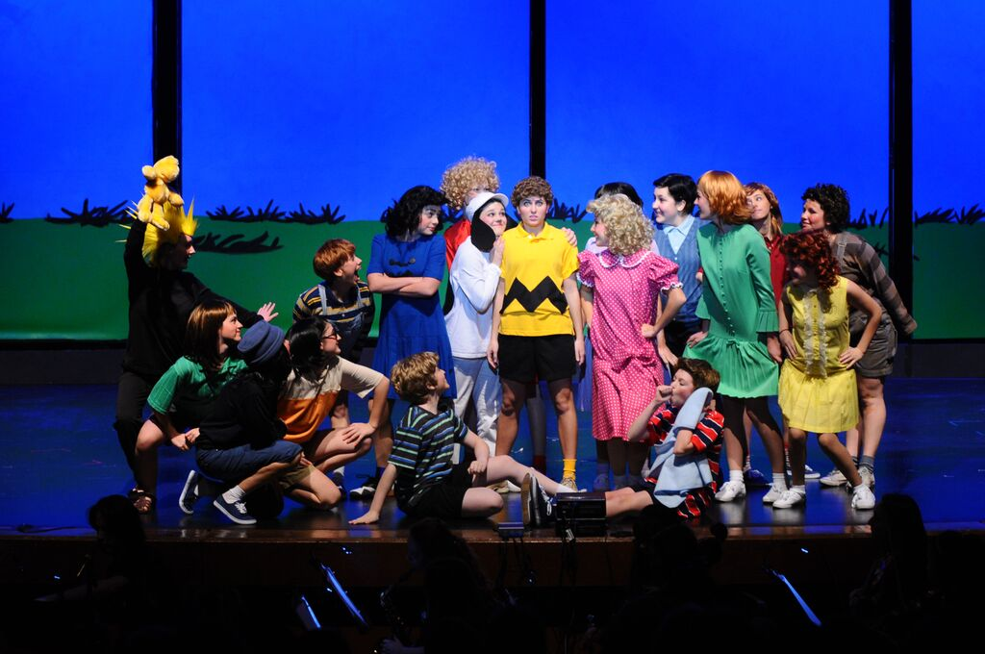
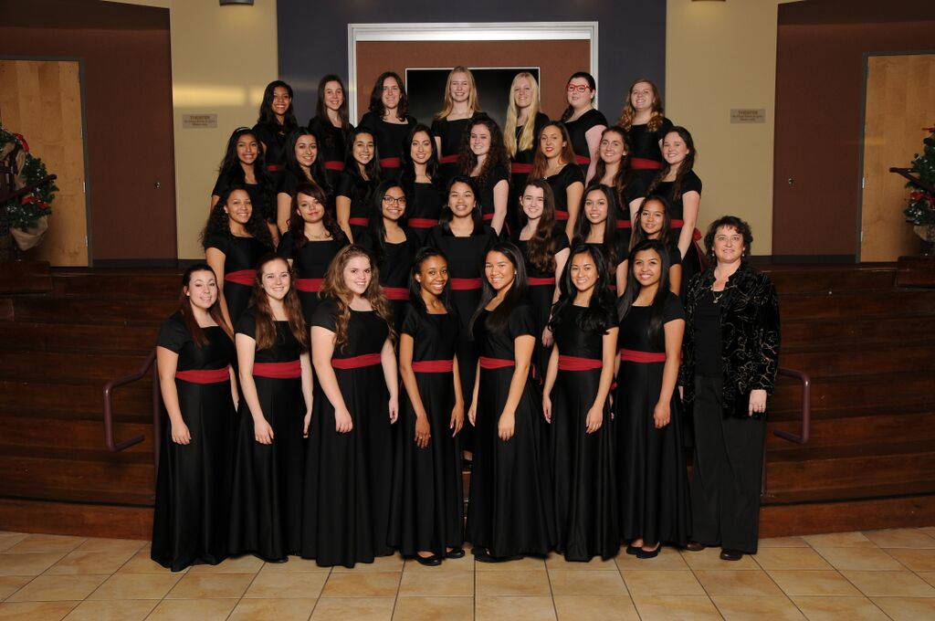

78% of St. Francis students participate in fine and performing arts.

Slide 8
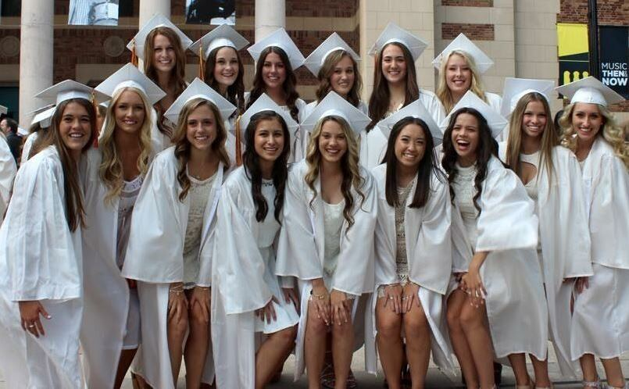
ACADEMIC EXCELLENCE
⬇99% of SFHS graduates
attend college.
⬇90% of Class of 2015 grads attend a
four-year college.
⬇The Class of 2015 earned $26 million in one-time and renewable scholarships.
⬇56% of SFHS 2015 grads attend college in California, and 43% attend college out of state.

Slide 9
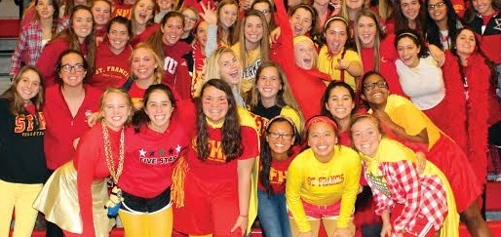

If you’d like to learn more about
St. Francis High School
Schedule a shadow day for your 8th
grade student
Visit the campus for a tour
Attend a game or arts performance
Check out the SFHS website:
stfrancishs.org
Follow us on social media

