Slide 1
Pick a Performing Art!
Click on each department for more information
Click HERE for a special video treat!
DANCE
Dance Styles
Intermediate Dance
Apprentice Co.
Dance Co.
THEATER
Theater Arts 1
Theater Arts 2
Honors Theater Arts 2
INSTRUMENTAL MUSIC
Orchestra
Honors Orchestra
Band
Honors Band
VOCAL MUSIC
Concert Choir
Chamber Singers
Honors Chamber Singers
Vocal Solos
And don’t forget INTRO to SHOW CHOIR
SHOW CHOIR
STAGECRAFT
Theater Tech
and Design

Slide 2
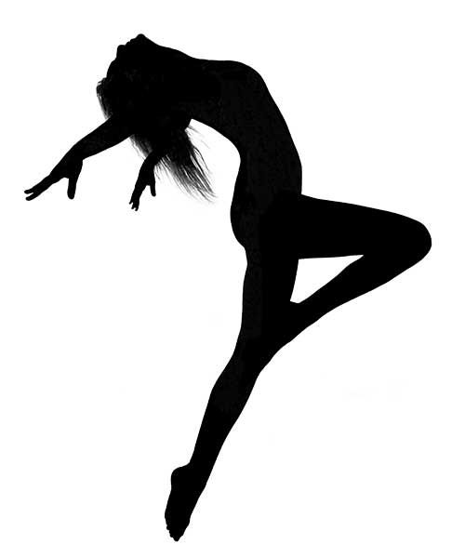
Dance!
Move your body!
MARK YOUR CALENDAR
Audition Workshops for Dance Co. plus Q&A on Feb 14th & 15th at lunch!
THE FOLLOWING CLASSES ARE OPEN TO ALL!
No audition required!
Dance Styles
Intermediate Dance
Are you an experienced dancer?
Dance Co is for students with intermediate or advanced dance experience & skill level.
Fill out this form to audition for Apprentice and SF Dance Company
Back to home page
Contact Ms. Agata Grzelak
Feel free to visit Ms. Agata in room 407 (dance studio) for Q&A during lunch or send her an email!

Slide 3
Sing
Express yourself!
Sing! Express your emotions!
Join the Concert Choir
OPEN TO ALL!
No audition required! Just sign up when you register for classes.
Contact Mrs. Tina Harris
If you have any questions
Or try Vocal Solos and focus on your solo voice!
Already an experienced singer?
Fill out this form to audition for
Chamber Singers or
Vocal Solos
Back to home page

Slide 4
Play! Embrace your passion!
Are you an experienced string or piano player?
Fill out this form to audition for Orchestra
Do you play a
woodwind, brass or percussion instrument?
Do you want to?
JOIN THE BAND!!!
Click HERE for the interest form
Back to home page
Contact Ms. Michelle See

Slide 5
Act!
Discover yourself!
Are you ready for something more advanced? Audition for Theater Arts II and/or Honors Theater II
Sign up for Theater Arts I and learn how to express yourself in a safe and loving environment
Complete this form to receive audition information
Back to home page
Contact Mrs. Kiera Anderson: kanderson@stfrancishs.org

Slide 6
Show Choir! Step out of the pack!
Give Intro to Show Choir a try for a fun and lively PE class full of singing and dancing
OR
Take it to the next level with
SHOW CHOIR
Fill out
this form for audition information
Live auditions are Wednesday, February 23rd from 4pm - 5pm in the SFHS Dance Room
Back to home page
Contact Mrs. Tina Harris
(There’s no need to re-audition if you’re currently in the class)

Slide 7
And what pulls it all together?
Theater Tech and Design
Do you have what it takes to be apart of the crew?
Fill out this form for more information
Back to home page
Contact Mr. Jeremy Toy

Slide 8
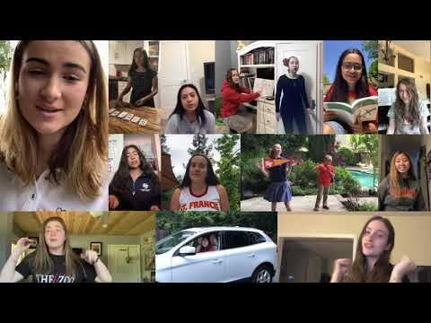
Back to home page

