Slide 1
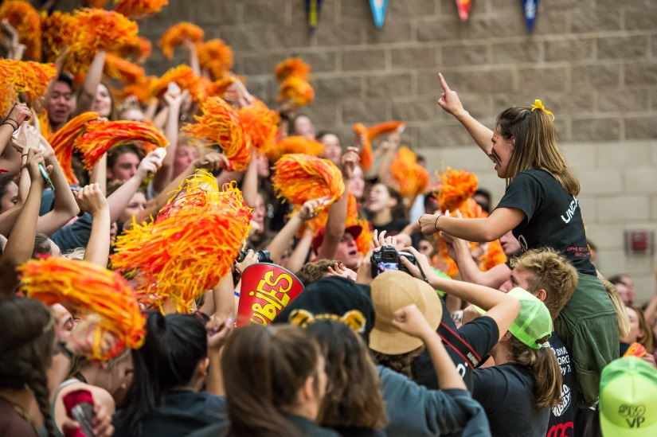
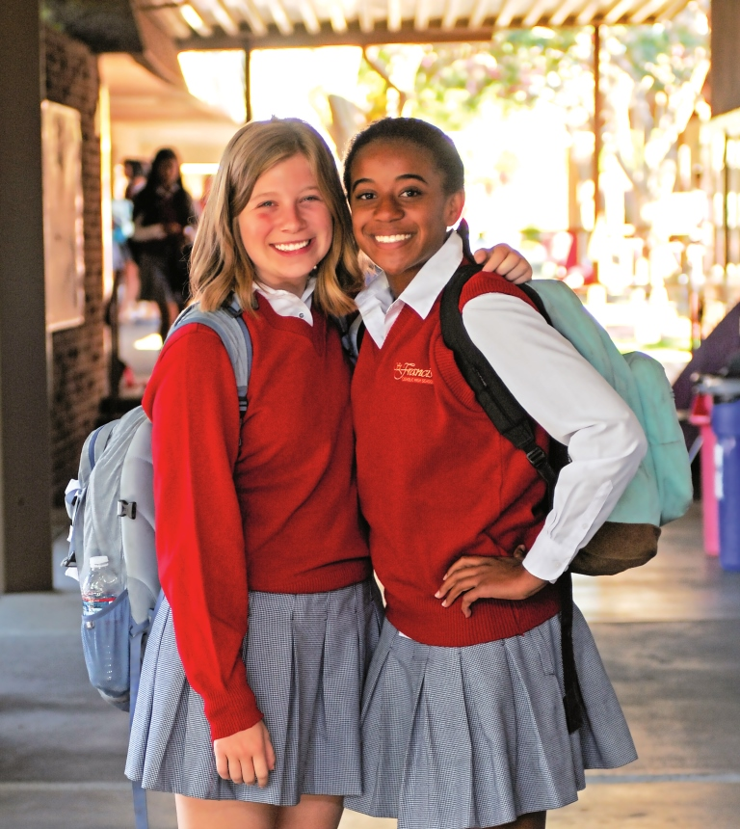
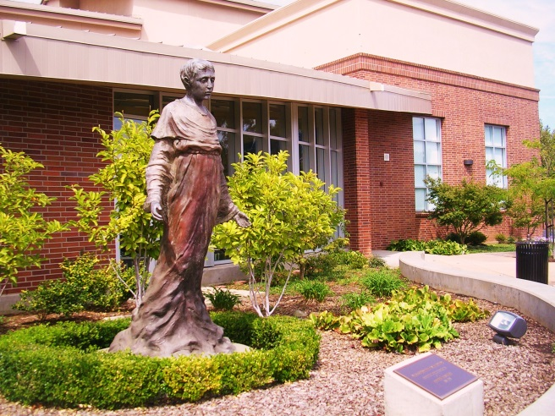
St. Francis High School

Slide 2
Four Years That Last a Lifetime

Slide 3
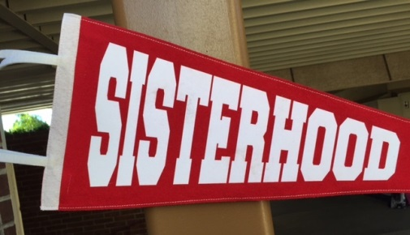
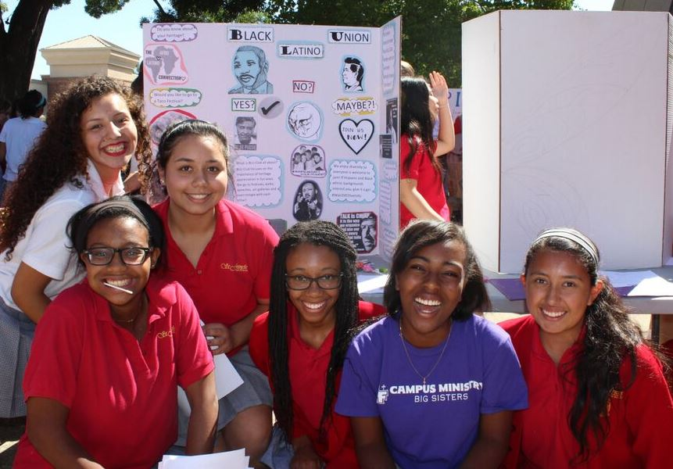
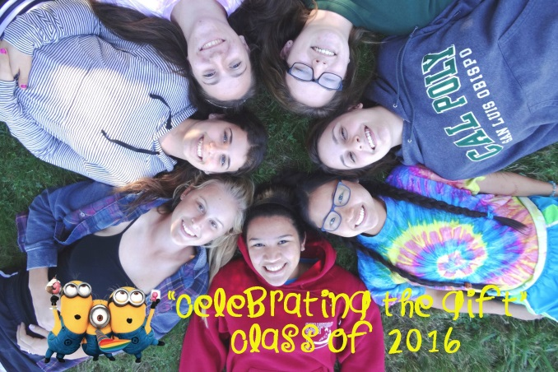
Community
Notes:
Retreats, Service, SISTERHOOD, discover your gifts and talents, Community of Faith

Slide 4
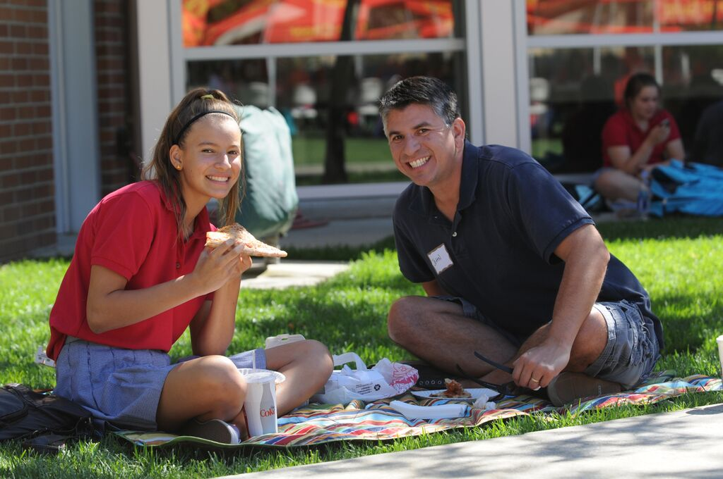
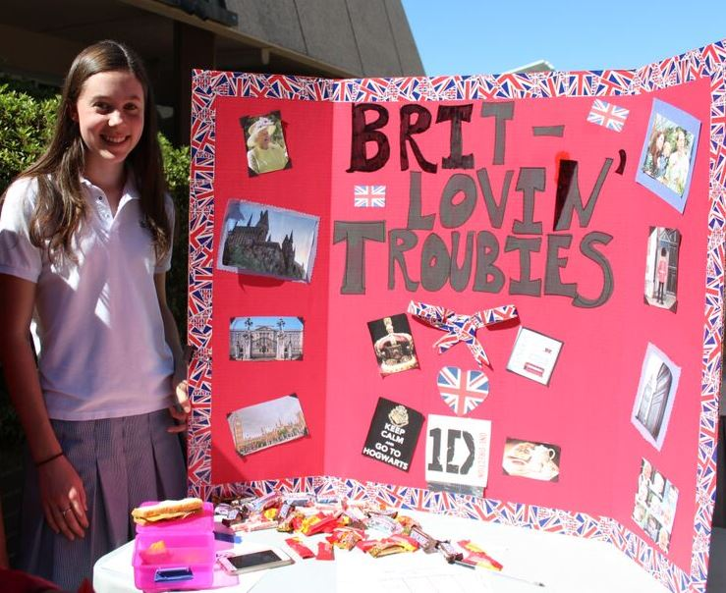
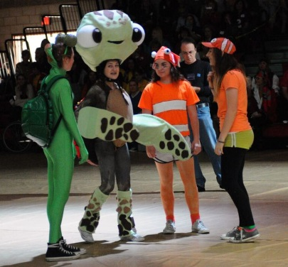
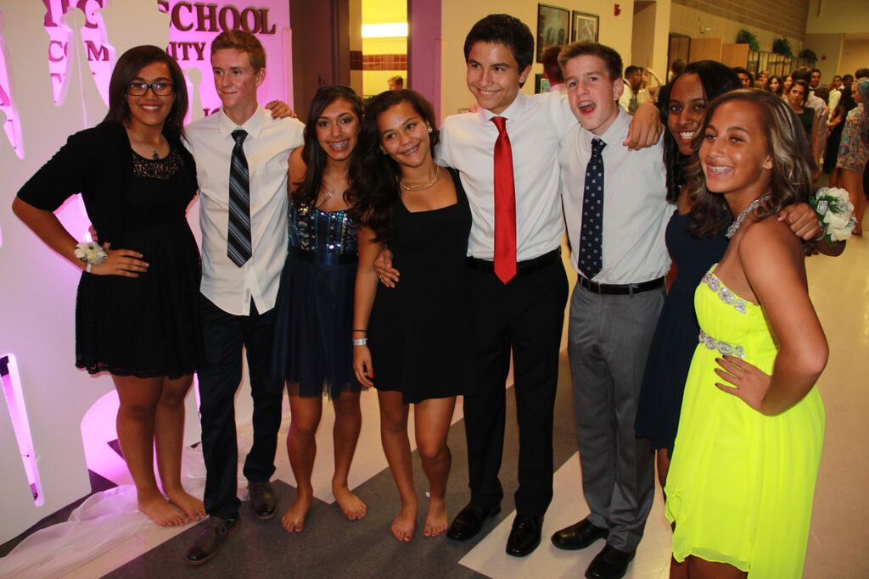
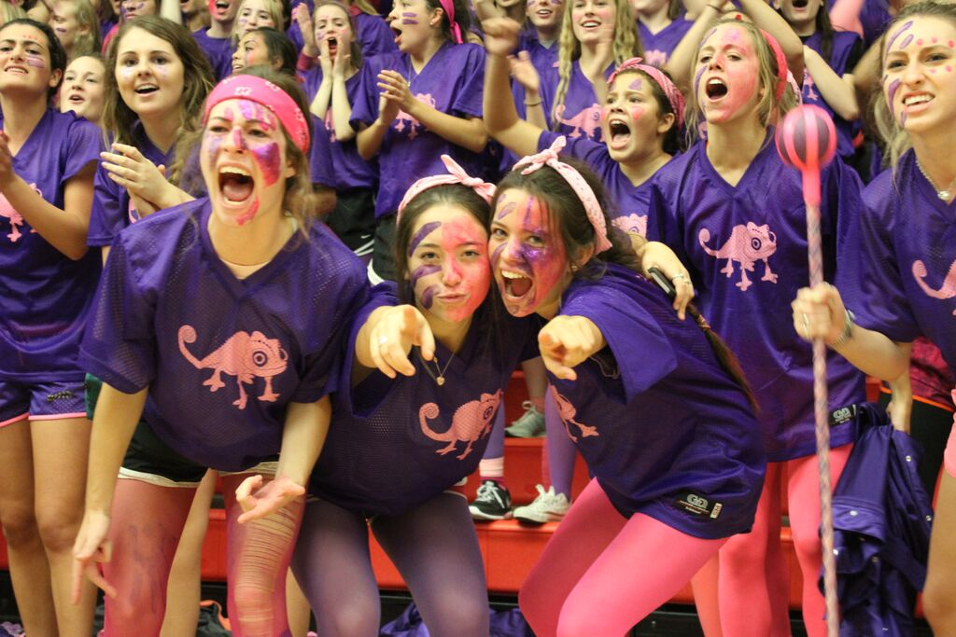
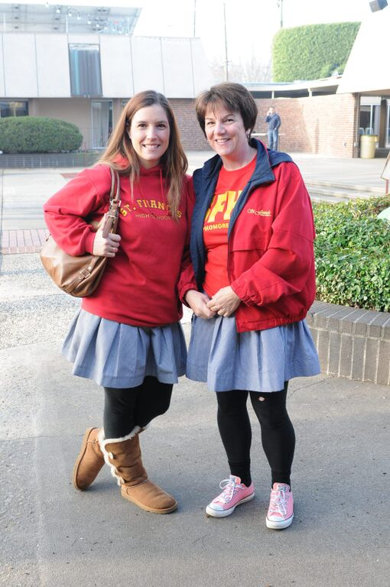
Tradition
Notes:
Coed dances, SWAP Day, we want parents on campus!

Slide 5
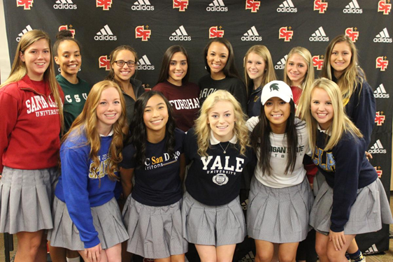
The All-Girls Advantage
80% of graduates of all-girls schools held leadership positions after high school.
Nearly three-fourths of girls’ school grads consider college a stepping stone to graduate school, and they are more than twice as likely to earn a doctoral degree.
Graduates of girls’ schools are six times more likely to consider majoring in math, science and technology; they are three times more likely to consider engineering careers.
Girls’ school grads spend more time studying, tutoring other students, and speaking with teachers outside of class.

Slide 6
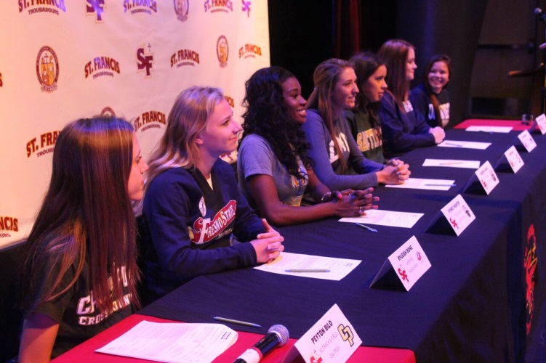
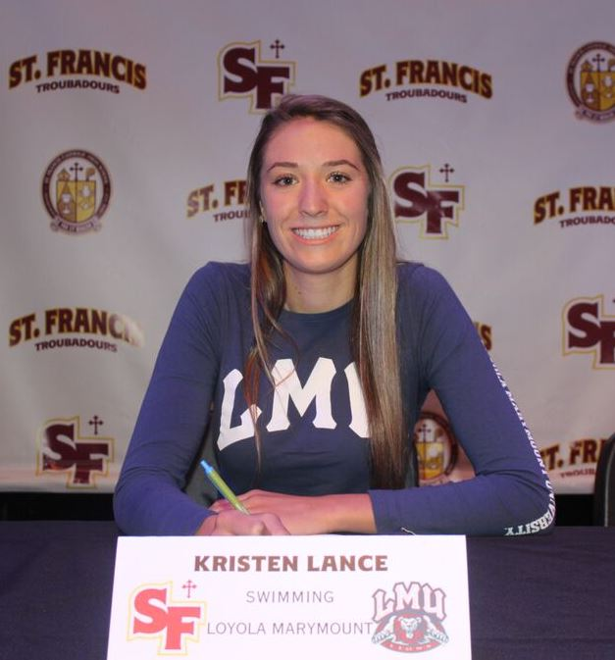
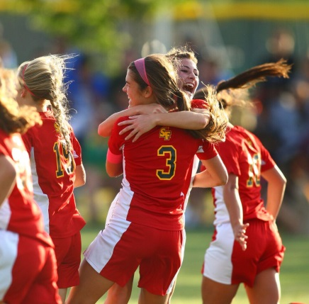
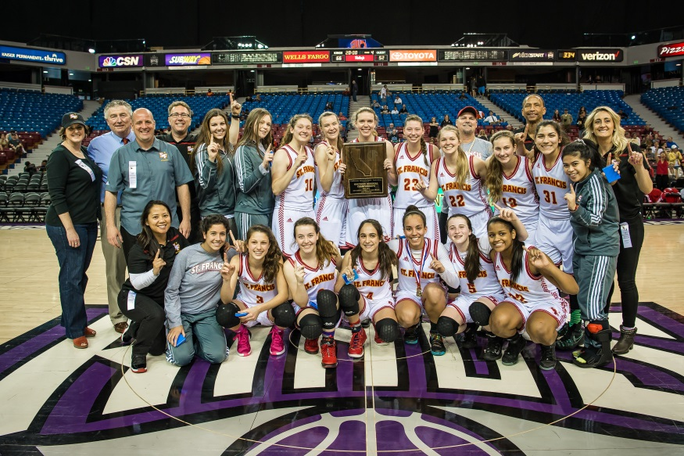
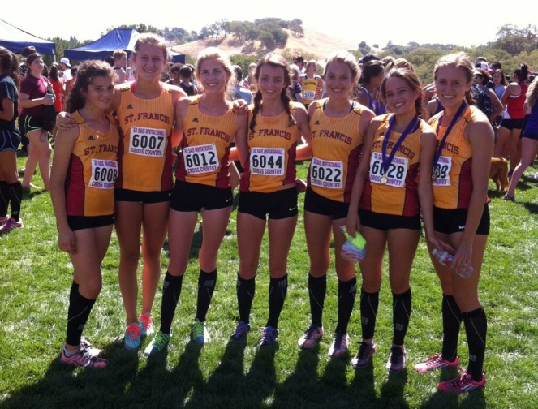
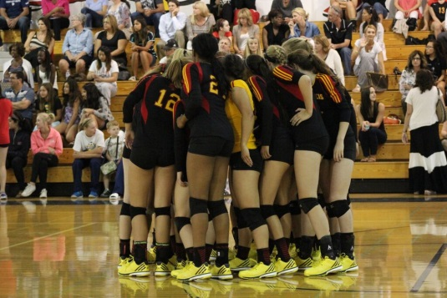
⬇SFHS has captured 91 Sac-Joaquin Section titles, more than any other girls’ program. ⬇In the last four years, 106 SFHS students have committed to play collegiate sports. ⬇2016 Northern California Division 1 Basketball Champions

Slide 7
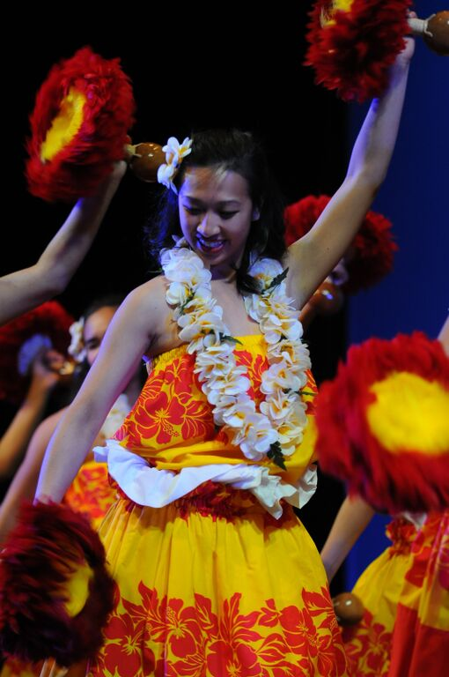
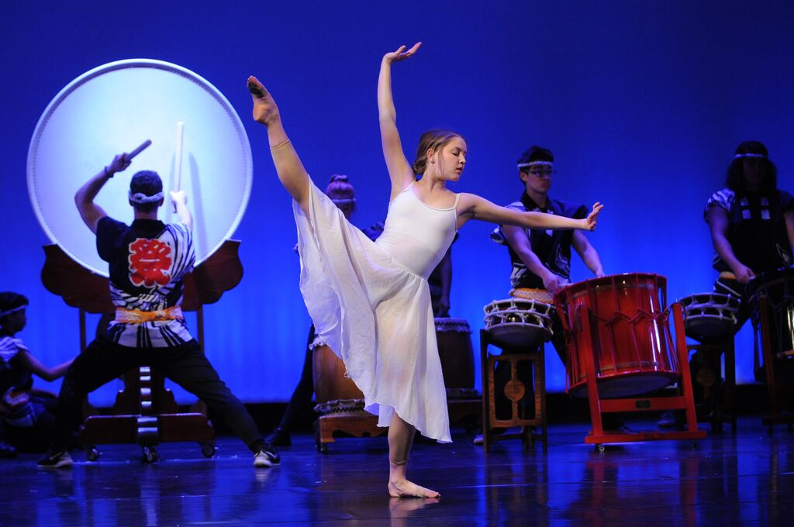
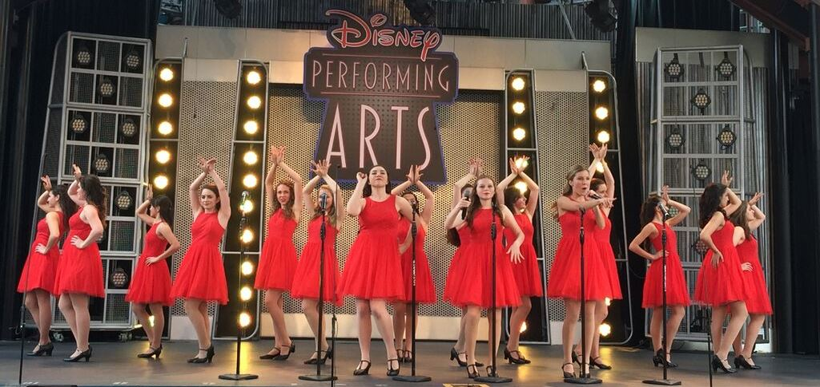
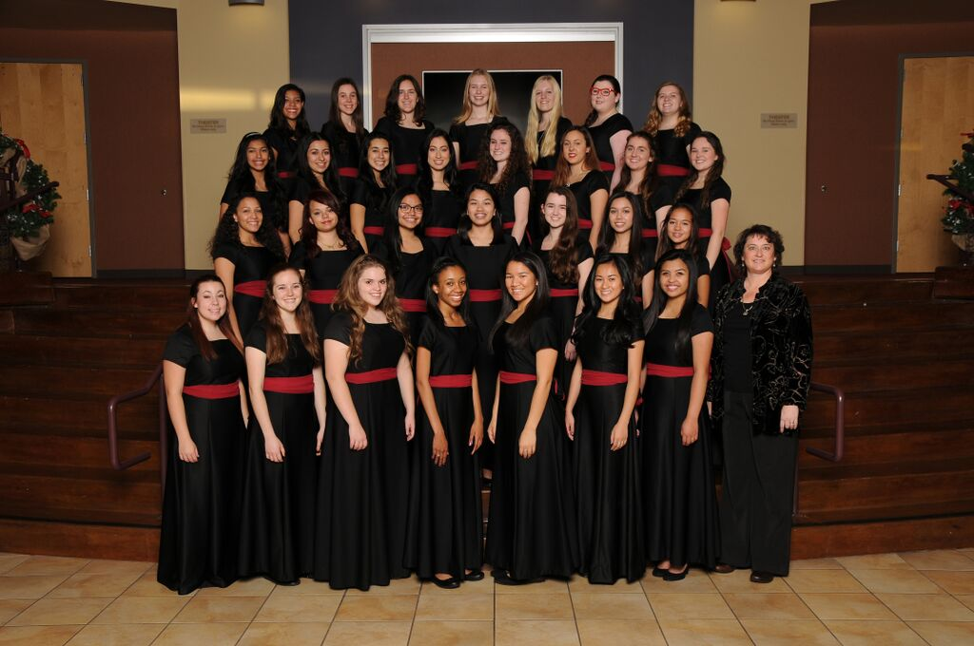
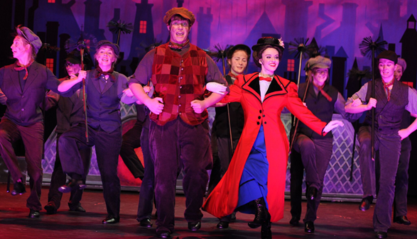
78% of St. Francis students participate in fine and performing arts.

Slide 8
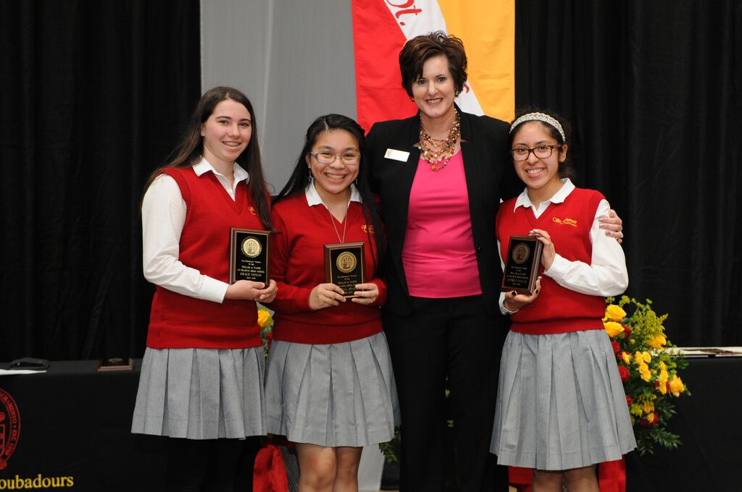
College Preparatory
28 Honors and AP classes
Advanced Placement Pass Rate: 87%
Average class size: 23
Student-teacher ratio: 1:14
Academic support resources
C-STEM program through UC Davis
8 Guidance counselors offer academic, college, and wellness counseling
8 academic teams

Slide 9
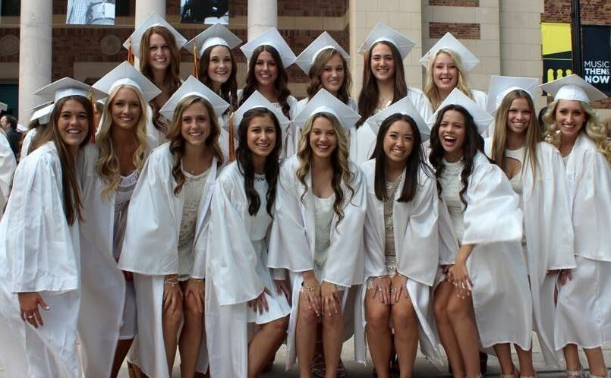
ACADEMIC EXCELLENCE
⬇99% of SFHS graduates attend college.
⬇90% of Class of 2016 grads attend a four-year college.
⬇The Class of 2016 earned $32 million in one-time and renewable scholarships.
⬇60% of SFHS 2016 grads attend college in California, and 40% attend college out of state.

Slide 10
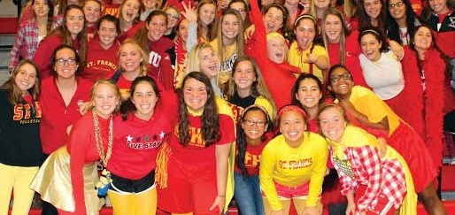
If you’d like to learn more about St. Francis High School
Schedule a shadow day for your 8th grade student
Visit the campus for a tour
Attend a game or arts performance
Check out the SFHS website: stfrancishs.org
Follow us on social media

